Slide 1
Upper Flint
Council Meeting
UPPER FLINT
August 24, 2022
waterplanning.georgia.gov

Slide 2
Agenda
Objectives:
Review and discuss surface water availability assessment results
Review and discuss revisions to management practices and recommendations
Consider revisions to recommendations from Plan Review & Inter-Council Coordination Committees
Discuss schedule for remaining plan revisions and meetings
10:00 | Welcome, Agenda Review, ARP Project Update – Mark Masters (GWPPC)
10:10 | Chair’s Report – Chairman Chase
10:20 | New Planning Timeline – Meagan Szydzik (GWPPC)
10:30 | Summary from last meeting – Courtney Cooper (GWPPC)
10:40 | EPD Update, Seed Grants – Johanna Smith (GAEPD)
10:50 | Orientation to goals for afternoon group discussions – Courtney Cooper (GWPPC)
11:00 | Surface Water Availability Assessment Results – Mark Masters (GWPPC) & Wei Zeng (GAEPD)
12:00 | Lunch
1:00 | Small Group Discussion: Surface Water Availability Assessment
2:00 | Water Quantity Committee report on revised recommendations – Raines Jordan
2:20 | Water Quality Committee report on revised recommendations – Beth English
2:40 | Break
2:50 | Inter-Council Coordination Committee report on revised joint recommendations – Donald Chase
3:05 | Full group discussion and report back
3:50 | Next Steps in Plan Review and Revision – Meagan Szydzik (GWPPC)
4:00 | Adjourn

Slide 3
Introductions
DONALD CHASE
Council Chair for:
Upper Flint
dgmkchase@gmail.com
(478) 472-7726
KRISTIN ROWLES
GWPPC
Council Lead for:
Upper Flint
krowles@h2opolicycenter.org
(404) 822-2395
MARK MASTERS
GWPPC
JOHANNA SMITH
Georgia EPD
Council Advisor for:
Upper Flint
mmasters@h2opolicycenter.org
Liaison for:
Upper Flint
Johanna.Smith@dnr.ga.gov
(470) 632-3158
STEPHEN SIMPSON
Black & Veatch
MEAGAN SZYDZIK
GWPPC
Council Advisor for:
Upper Flint
mszydzik@h2opolicycenter.org
(770) 543-8497
Council Advisor for:
Upper Flint
simpsonsl@bv.com
(770) 521-8105
CORINNE VALENTINE
Black & Veatch
Council Advisor for:
Upper Flint
valentinec@bv.com
(770) 752-5256
COURTNEY COOPER
GWPPC
Council Advisor for:
Lower Flint-Ochlockonee
ccooper@h2opolicycenter.org
JAKE DEAN
Black & Veatch
Council Advisor for:
Upper Flint
deanj1@bv.com
(770) 521-8153

Slide 4
Upper Flint Council Members
Name | City | County
Brian Belcher | Ellaville | Schley
Barry Blount | Americus | Sumter
Michael Bowens | Vienna | Dooly
Gene Brunson | Reynolds | Taylor
Thomas Burnsed | Meansville | Pike
Donald Chase, Chair | Oglethorpe | Macon
Brad Ellis | Vienna | Dooly
Beth English | Vienna | Dooly
Steve Fry | Williamson | Pike
Adam L. Graft | Americus | Sumter
Rodney H. Hilley | Molena | Pike
Jack Holbrook (Alternate) | Preston | Webster
Terrell Hudson | Unadilla | Dooly
Raines Jordan, Vice Chair | Talbotton | Talbot
Brant Keller (Alternate) | Griffin | Spalding
Bob Melvin | Oglethorpe | Macon
Kenneth L. Murphy | Gay | Meriwether
Sen. Ed Harbison (Ex-Officio)
Name | City | County
Lamar Perlis | Cordele | Crisp
Gary Powell | Buena Vista | Marion
Jim Reid | Americus | Sumter
Gordon Rogers | Talbotton | Talbot
Charles Rucks | Brooks | Spalding
Bill Sawyer | Ellaville | Schley County
Larry Smith | Montezuma | Macon
Marcus South | Thomaston | Upson
Walter E. (Butch) Turner | Reynolds | Taylor
Brian Upson | Griffin | Spalding
George (Teel) Warbington (Alternate) | Vienna | Dooly
Rodney Wilson | Zebulon | Pike
Benjamin (Joel) Wood | Cordele | Crisp
Ben Haugabook |  | Macon

Slide 5
Chair’s Report
Presented by Chairman Chase

Slide 6
New Planning Timeline
Meagan Szydzik

Slide 7
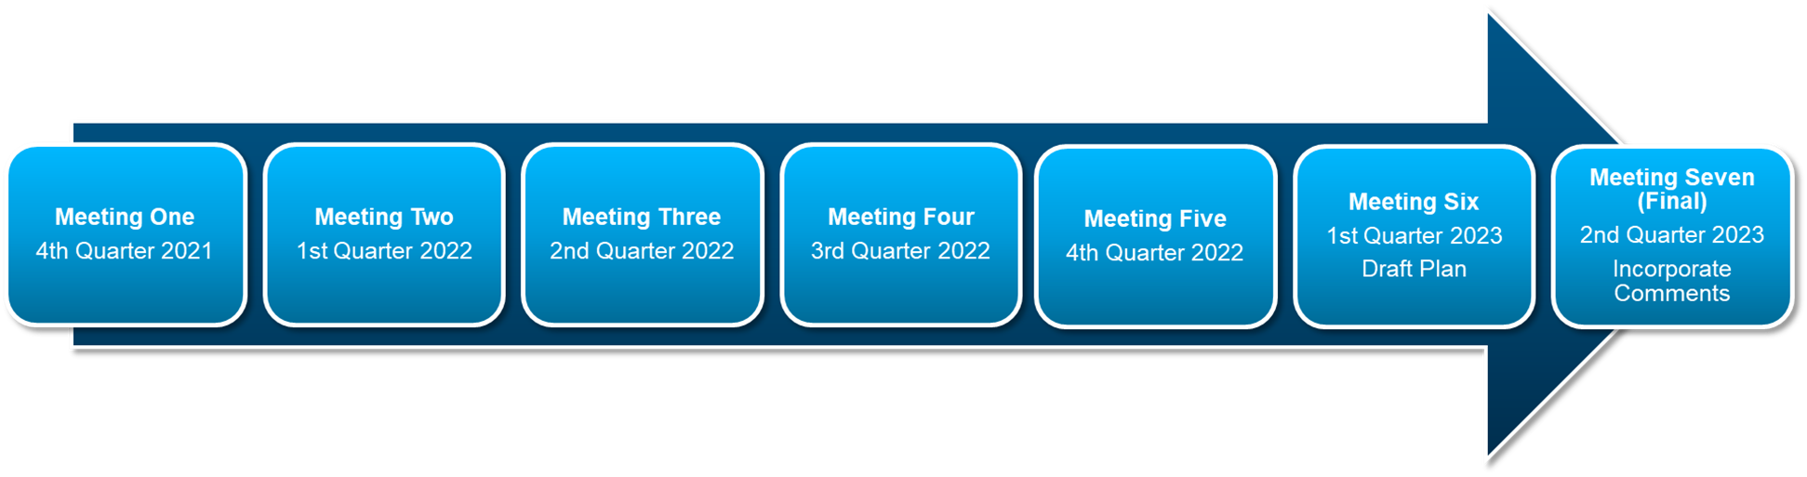
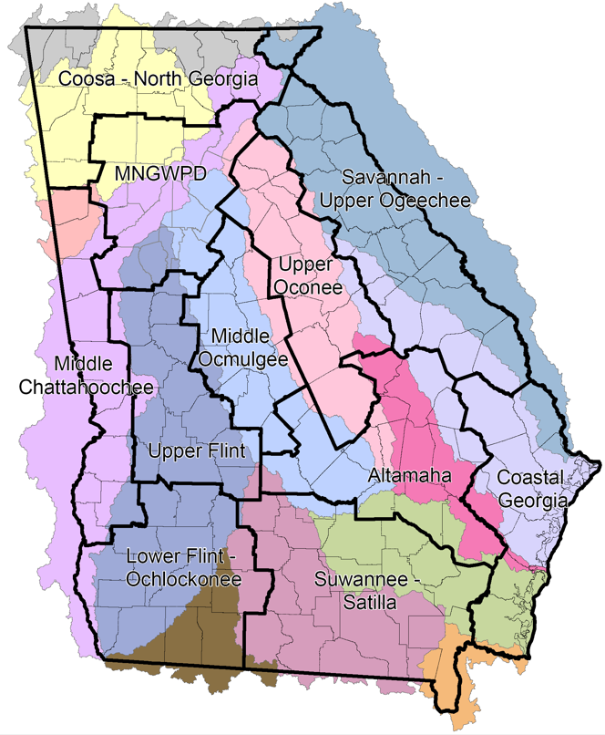
Regional Water Plan Update
Regional Water Plan Review and Revision Schedule
EPD targeted date of
adoption of revised
Regional Water Plan by
June 2023

Slide 8
Previous Meeting Summary
Courtney Cooper

Slide 9
Previous Meeting Summary
Reviewed additional water resource assessment results
Reviewed and discussed management practices and recommendations
Considered recommendations from Plan Review & Inter-Council Coordination Committees
Learned about recent studies on water system interconnectivity and biosolids management
Notes:
Is there anything specific that is important review for those who were not able to attend

Slide 10
EPD Update, Seed Grants
Johanna Smith, GAEPD

Slide 11
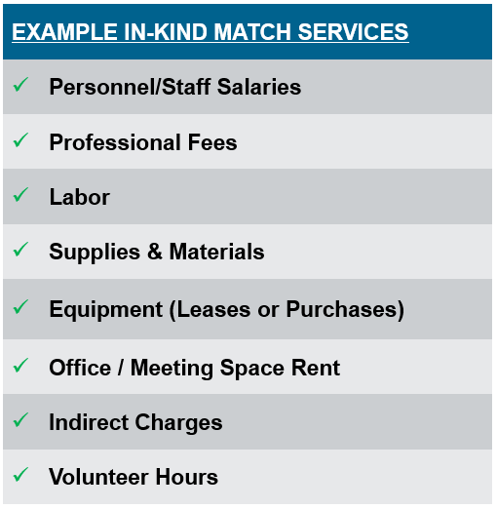
FY23 RWP Seed Grant Program
EPD made grant announcement on July 7
Funding for projects that implement Regional Water Plan management practices/recommendations
Letter of endorsement from Council Chair
Up to $75,000 state funding available (per project)
Cost-Share: 60% state /40% match (with at least 10% cash match)
Pre-application meeting & application deadlines in October

Slide 12
Seed Grant History & Awards
Since State Fiscal Year 2014, EPD has awarded $1,966,900 in state funds to Seed Grant projects
Projects support implementation of Regional Water Plans
In the Upper Flint region, $176,000 of state funds have been awarded towards 3 total seed grant projects
  Including match, the total project spending is $296,000

Slide 13
Seed Grant Projects in this Region
FY14 seed grant to Albany State GWPPC
  “Water Supply Alternatives Development Plan for Agricultural Irrigators in Ichawaynochaway Sub-Basin (HUC 03130009)”
FY18 seed grant to Two Rivers RC&D
  “Microbial Source Tracking for Species Identification in the Ulcohatchee Creek Watershed”
FY18 seed grant to UGA/Stripling Irrigation Research Park
  “Innovative Ag Irrigation Scheduling Tools for Increasing Water Use Efficiency in the Lower Flint-Ochlocknee and the Upper Flint Regional Water Council Areas”
FY21 seed grant to University of Georgia
  “Pike County Plans for the Future by Building on the Upper Flint Regional Water Plan”

Slide 14
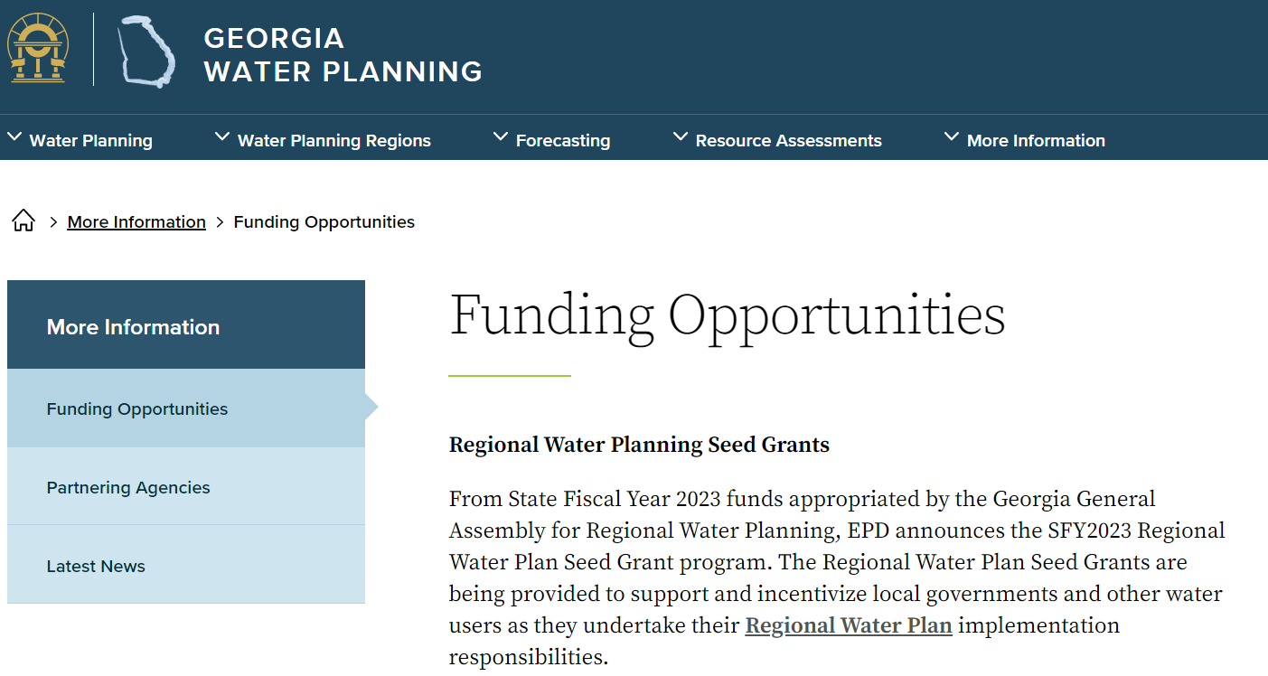
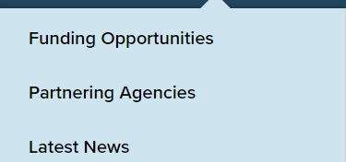
More Information on Seed Grants
waterplanning.georgia.gov

Slide 15
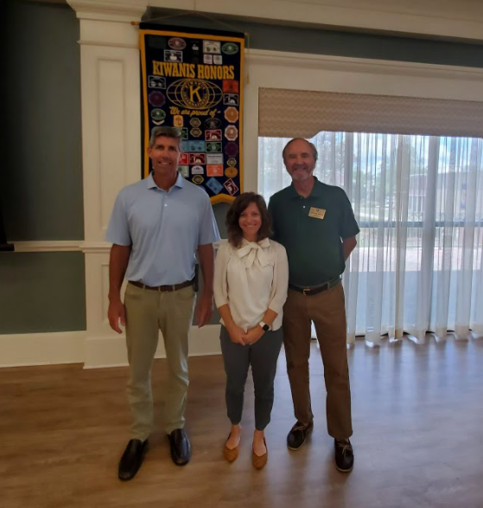
Upper Flint Region: Public Outreach
Friday, Aug. 5 Americus Kiwanis Club Meeting
  Thanks to Adam Graft for attending!
  Provided overview of Georgia EPD and State Water Planning process
  Future public outreach opportunities are highly encouraged for council members

Slide 16
Orientation to goals for afternoon group discussions
Courtney Cooper

Slide 17
Small group discussions
What are your primary takeaways from the water availability assessment?
  What implications do they have for you?
Are there any new issues not yet reflected in the recommendations?
  Do the results mesh with the revised plan recommendations?
What else do you want to know about water availability?
  Are there other metrics that you would like to see?
If you had sufficient funds, what water-related projects would you prioritize over the next 5 years?
Discuss any unsettled committee items

Slide 18
Surface Water Availability Assessment Results
Mark Masters & Wei Zeng

Slide 19
Presentation Outline
Introduction and Model Settings
Model Results
  Water Supply Challenges
  Wastewater Assimilation Challenges
  Carsonville Flow Results

Slide 20
Upper Flint Region Metrics
Water Supply Availability | % model period with water supply challenge
 | Total volume of shortage
 | Shortage volume in 2007-2008 drought
 | Shortage volume in 2011-2012 drought
Wastewater Discharge Assimilation | % model period with wastewater assimilation challenge
 | Total volume of shortage
Lake Elevation | N/A
Streamflow | Carsonville - 100 cfs
 | Carsonville - 600 cfs
Does the Council have additional metrics to consider?
Notes:
Columbus flow (daily and 7-day average) against 1,350 cfs
Bainbridge flow against monthly low observed in 2011 and 2012
Iron City flow of 8 cfs derived from a 4.6 cfs flow threshold at Colquitt triggering flow augmentation
Milford flow of 50 cfs associated with GAFIT threshold

Slide 21
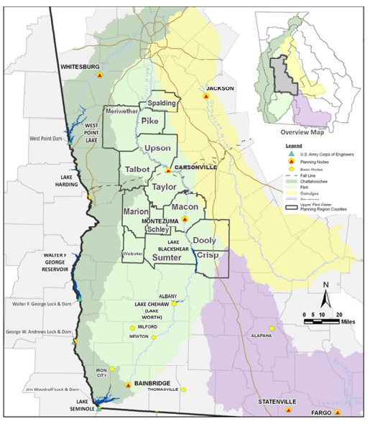
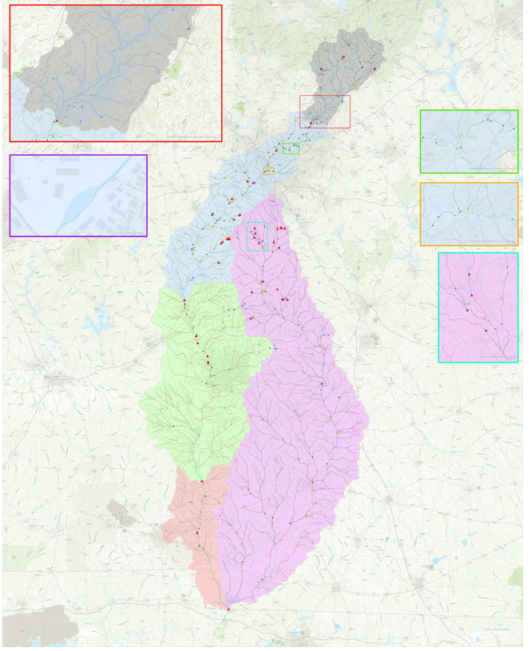
Upper Flint Region and ACF Model Domain

Slide 22
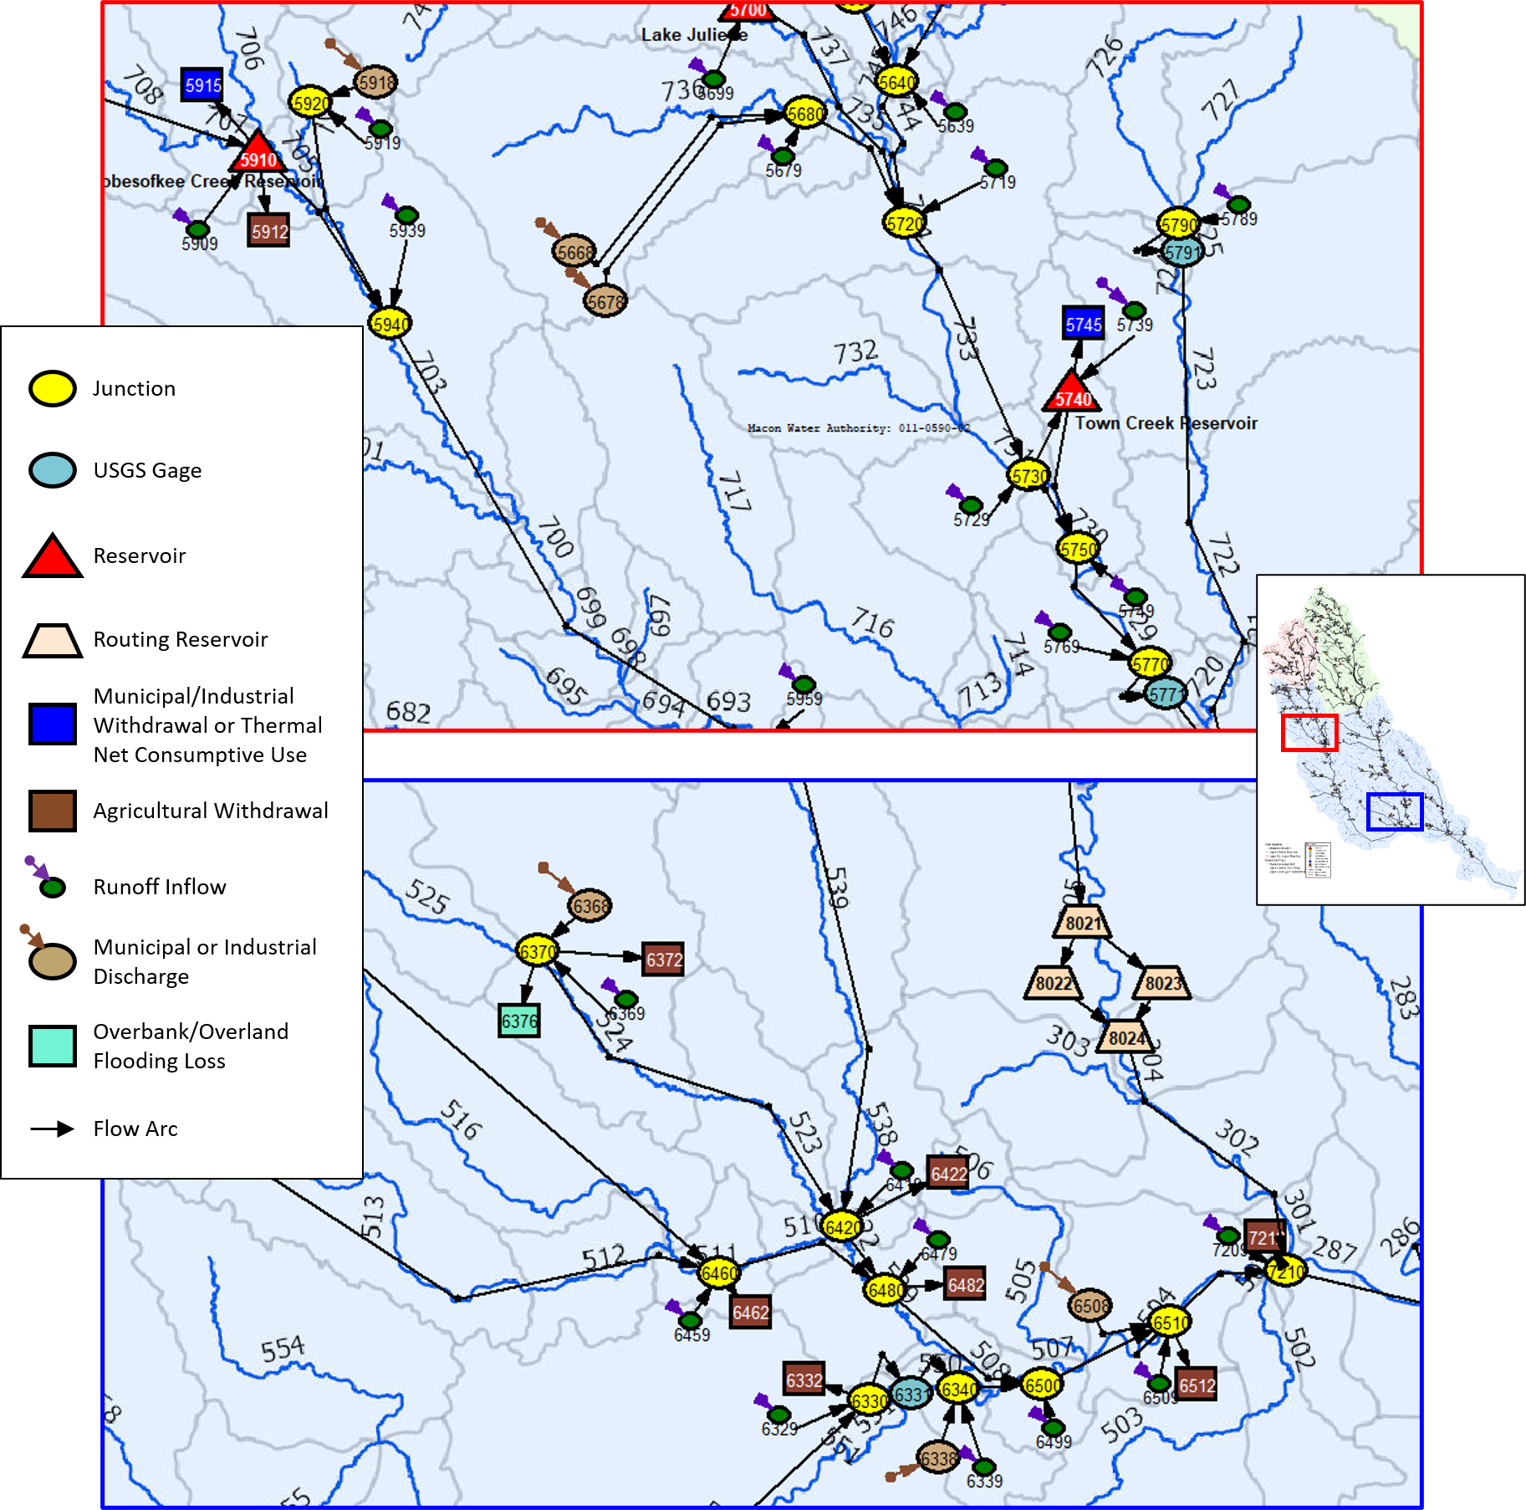
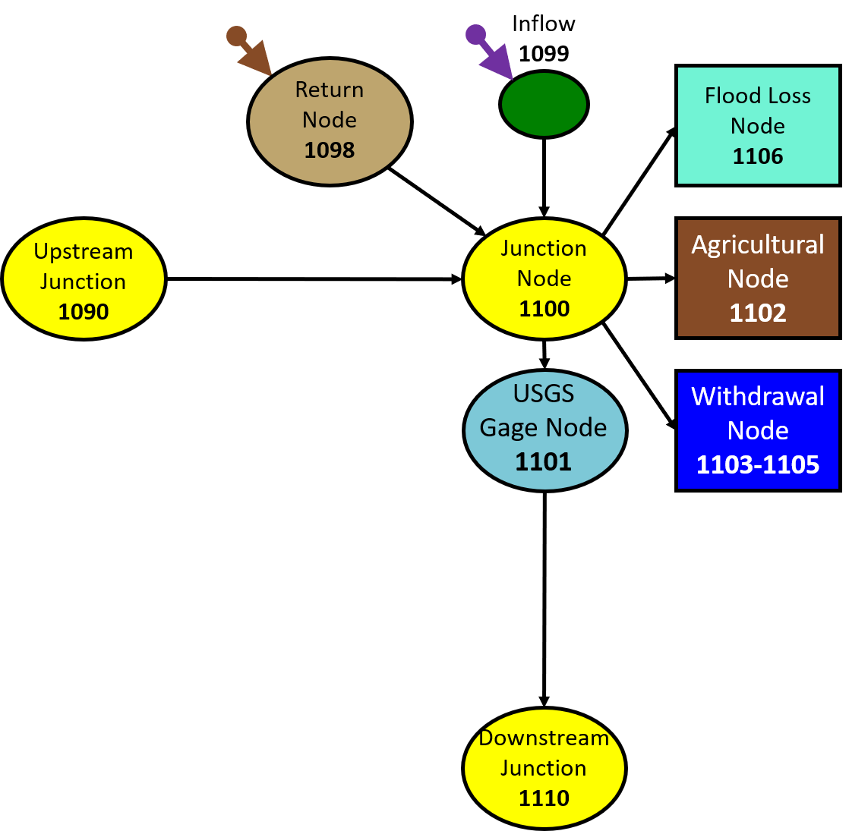
BEAM Node Types

Slide 23
ACF Baseline & Future Scenarios Settings
Simulation Period | 1939 – 2018 (model period includes various hydrologic conditions)
Withdrawal and Discharge Amounts | 4 Scenarios Baseline: Average water and wastewater demands for 2010-2018 Baseline Drought: 2011 demands Forecast (ag constant): 2060 demands but agriculture held constant at baseline Forecast (ag growth): 2060 demands with agriculture 2060 forecast
Instream Flow Protection Thresholds | Per permit conditions
Reservoir physical and operational data | From reservoir owner or GAEPD

Slide 24
Water & Wastewater Facilities Analyzed in the Upper Flint Region
 | Facility Type | Analyzed (# of facilities) | Challenge Indicated (# of facilities)
Water Withdrawals | Municipal | 10 | 4
 | Industrial | 5 | 3
 | Energy | 0 | 0
Wastewater Discharges | Municipal | 16 | 11
 | Industrial | 1 | 0
Note: Energy withdrawals are expressed as consumptive uses in modeling.

Slide 25
Facilities With Water Supply Challenges (page 1)
 | Scenario | Covia Holdings Corp. | Southern Mills, Inc. | Roosevelt Warm Springs Institute | City of Warm Springs
BEAM Node |  | 4525 | 6825 | 6884 | 6885
Waste Supply Challenge (% Days) | Baseline | 0.06% | 4.9% | 0.4% | 0.02%
 | Baseline Drought | 0.05% | 4.3% | 0.2% | 0.0%
 | Forecast (ag constant) | 0.06% | 4.9% | 1.2% | 0.3%
 | Forecast (ag growth) | 0.05% | 4.9% | 1.2% | 0.3%
Shortage Volume (million gallons) | Baseline | 1.0 2007-08 drought: 0 2011-12 drought: 0 | 283 2007-08 drought: 34 2011-12 drought: 61 | 11 2007-08 drought: 3 2011-12 drought: 4 | 0.1 2007-08 drought: 0 2011-12 drought: 0
(million gallons) | Baseline Drought | 0.7 2007-08 drought: 0 2011-12 drought: 0 | 232 2007-08 drought: 38 2011-12 drought: 52 | 3 2007-08 drought: 1 2011-12 drought: 1 | 0 2007-08 drought: 0 2011-12 drought: 0
 | Forecast (ag constant) | 1.0 2007-08 drought: 0 2011-12 drought: 0 | 283 2007-08 drought: 38 2011-12 drought: 61 | 68 2007-08 drought: 15 2011-12 drought: 14 | 12 2007-08 drought: 4 2011-12 drought: 5
 | Forecast (ag growth) | 1.0 2007-08 drought: 0 2011-12 drought: 0 | 283 2007-08 drought: 38 2011-12 drought: 61 | 68 2007-08 drought: 15 2011-12 drought: 14 | 12 2007-08 drought: 4 2011-12 drought: 5

Slide 26
Facilities With Water Supply Challenges (page 2)
 | Scenario | City of Manchester | City Of Thomaston | Covia Financial Corporation
BEAM Node |  | 7045 | 7195 | 7555
Waste Supply Challenge (% Days) | Baseline | 15.8% | 3.1% | 0.1%
 | Baseline Drought | 15.9% | 3.3% | 0.1%
 | Forecast (ag constant) | 9.5% | 2.5% | 0.1%
 | Forecast (ag growth) | 9.5% | 2.3% | 0.1%
Shortage Volume (million gallons) | Baseline | 3,763 2007-08 drought: 326 2011-12 drought: 426 | 1,584 2007-08 drought: 354 2011-12 drought: 301 | 11 2007-08 drought: 0 2011-12 drought: 0
(million gallons) | Baseline Drought | 3,830 2007-08 drought: 331 2011-12 drought: 434 | 1,642 2007-08 drought: 379 2011-12 drought: 327 | 17 2007-08 drought: 0 2011-12 drought: 0
 | Forecast (ag constant) | 907 2007-08 drought: 100 2011-12 drought: 129 | 815 2007-08 drought: 202 2011-12 drought: 146 | 10 2007-08 drought: 0 2011-12 drought: 0
 | Forecast (ag growth) | 907 2007-08 drought: 100 2011-12 drought: 129 | 738 2007-08 drought: 189 2011-12 drought: 142 | 10 2007-08 drought: 0 2011-12 drought: 0

Slide 27
Facilities With Wastewater Assimilation Challenges
 |  | Concord: South WPCP | City of Warm Springs WPCP | Thomaston: Bell Creek WPCP | Reynolds WPCP | Taylor Cty: Plant Laurel WPCP | Buena Vista WPCP | Byromville WPCP | Cordele: Gum Creek WPCP | Ellaville WPCP-1 (GA0050105) | Ellaville WPCP-2 (GA0047767) | Ellaville WPCP-3 (GA0020931)
BEAM Node |  | 6798 | 6878 | 7218 | 7318 | 7498 | 7618 | 7728 | 7768 | 7848 | 7878 | 7978
7Q10 Flow (cfs) |  | 3.76 | 0.64 | 13.47 | 33.39 | 4.86 | 1.29 | 2.85 | 2.56 | 0.03 | 10.54 | 0.11
Wastewater Challenge (% Days) | Baseline | 2.4% | 1.1% | 2.0% | 1.1% | 0.3% | 0.0% | 8.4% | 2.6% | 0.05% | 0.7% | 0.0%
 | Baseline Drought | 2.7% | 0.7% | 2.3% | 1.2% | 0.3% | 0.0% | 16.0% | 4.4% | 0.1% | 3.2% | 0.01%
 | Forecast (ag constant) | 2.4% | 1.6% | 1.6% | 1.1% | 0.3% | 0.0% | 8.4% | 2.6% | 0.05% | 0.7% | 0.0%
 | Forecast (ag growth) | 2.2% | 1.6% | 1.5% | 1.2% | 0.3% | 0.0% | 18.2% | 4.8% | 0.1% | 1.1% | 0.0%
Shortage Volume (million gallons) | Baseline | 836 | 76 | 1,380 | 2,024 | 92 | 0 | 1,716 | 1,460 | 1 | 657 | 0
(million gallons) | Baseline Drought | 977 | 45 | 1,905 | 2,075 | 117 | 0 | 4,590 | 2,604 | 1 | 4,423 | 0.3
 | Forecast (ag constant) | 836 | 147 | 1,003 | 2,024 | 92 | 0 | 1,713 | 1,436 | 2 | 638 | 0
 | Forecast (ag growth) | 762 | 147 | 825 | 2,042 | 100 | 0 | 5,924 | 2,965 | 5 | 1359 | 0
WPCP=Water Pollution Control Plant

Slide 28
Carsonville Flow Summary | Scenario | Metric
 |  | 100 cfs | 600 cfs
% Days Below Metric | Baseline | 0.26% | 22.6%
 | Baseline Drought | 0.44% | 23.0%
 | Forecast (ag constant) | 0.044% | 23.7%
 | Forecast (ag growth) | 0.034% | 23.6%
Notes:
1. USGS gage 02347500 had 103 days of flow less than 100 cfs for the 2011-2012 period.

Slide 29
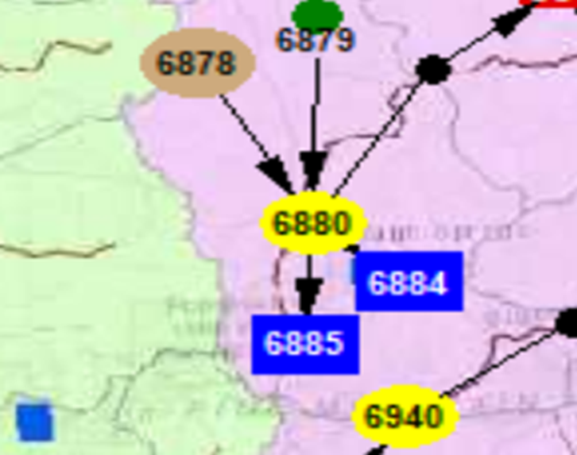
Water Supply Challenge Example 1
Permit holder: City of Warm Springs
Permit 099-1106-07, BEAM Node 6885
Withdrawal limits: 0.33 mgd (daily)/0.24 mgd(monthly)

Slide 30
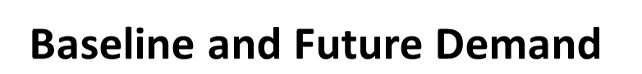
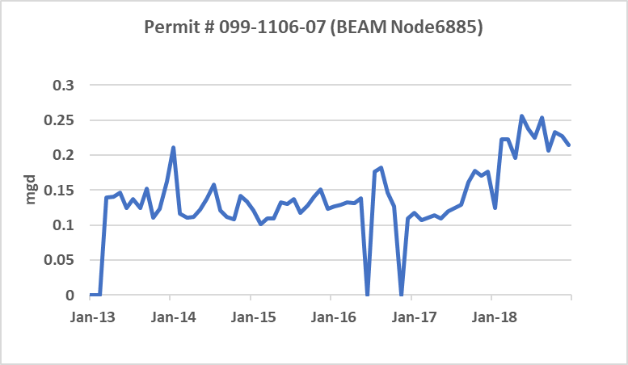
City of Warm Springs
Permit 099-1106-07
Withdrawal Amount Setting
Average of 2010-2018
Baseline: Average demands 2010-2018
Baseline Drought: 2011 demands
Forecast (ag constant)2060 demands with ag held constant at baseline
Forecast (ag growth): 2060 demands with ag projected growth

Slide 31
Water Supply Challenge in 2000
Baseline: Average demands 2010-2018
Baseline Drought: 2011 demands
Forecast (ag constant): 2060 demands with ag held constant at baseline
Forecast (ag growth): 2060 demands with ag projected growth

Slide 32
Water Supply Challenge in 2007
Baseline: Average demands 2010-2018
Baseline Drought: 2011 demands
Forecast (ag constant): 2060 demands with ag held constant at baseline
Forecast (ag growth): 2060 demands with ag projected growth

Slide 33
Water Supply Shortage Frequency in 1939-2018
Baseline: Average demands 2010-2018
Baseline Drought: 2011 demands
Forecast (ag constant): 2060 demands with ag held constant at baseline
Forecast (ag growth): 2060 demands with ag projected growth

Slide 34

Water Supply Challenge Example 2
Permit holder: Roosevelt Warm Springs Institute
Permit 099-1106-04, BEAM Node 6884
Withdrawal limits: 0.144 mgd (daily/monthly)
Cascade Creek IFPT of 0.3 cfs (0.19 mgd)

Slide 35
Roosevelt Warm Springs Institute (Permit 099-1106-07):
Withdrawal Amount Setting-average of 2010-2018 and 2060 projection
2010 - 2018
Baseline and Future
Baseline: Average demands 2010-2018
Baseline Drought: 2011 demands
Forecast (ag constant): 2060 demands with ag held constant at baseline
Forecast (ag growth): 2060 demands with ag projected growth

Slide 36
Water Supply Challenge in 2007
Baseline: Average demands 2010-2018
Baseline Drought: 2011 demands
Forecast (ag constant): 2060 demands with ag held constant at baseline
Forecast (ag growth): 2060 demands with ag projected growth

Slide 37
Water Supply Challenge in 2011
Baseline: Average demands 2010-2018
Baseline Drought: 2011 demands
Forecast (ag constant): 2060 demands with ag held constant at baseline
Forecast (ag growth): 2060 demands with ag projected growth

Slide 38
Water Supply Shortage Frequency in 1939-2018
Baseline: Average demands 2010-2018
Baseline Drought: 2011 demands
Forecast (ag constant): 2060 demands with ag held constant at baseline
Forecast (ag growth): 2060 demands with ag projected growth

Slide 39
Wastewater Assimilation Challenge
Wastewater increases with population growth, which may also bring challenge to water resource management.
Effluent limitation is determined by two factors:
  Available technology – technology based effluent limitations
  Water quality standards – upholding water quality standards in the receiving water body - 7Q10 flow is usually used as low flow threshold for determining wastewater assimilation and NPDES permit limitations

Slide 40
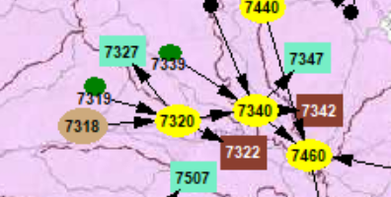
Wastewater Assimilation Challenge Example
Permit holder: City of Reynolds (Reynolds WPCP)
Permit GA 0020729, BEAM Node 7318
Permitted monthly discharge flow: 0.4 mgd
7Q10 Flow at discharge location: 33.39 cfs

Slide 41
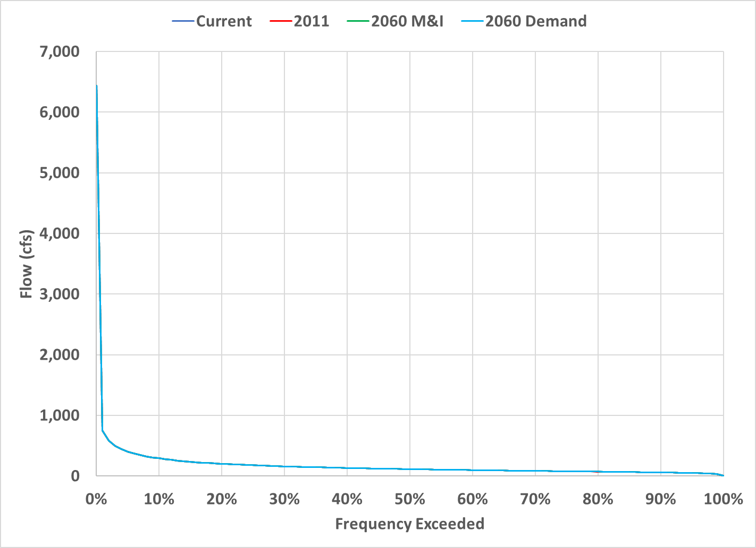
Simulation Results at Reynolds (GA 0020729) Location Flow Frequency
Baseline: Average demands 2010-2018
Baseline Drought: 2011 demands
Forecast (ag constant): 2060 demands with ag held constant at baseline
Forecast (ag growth): 2060 demands with ag projected growth

Slide 42
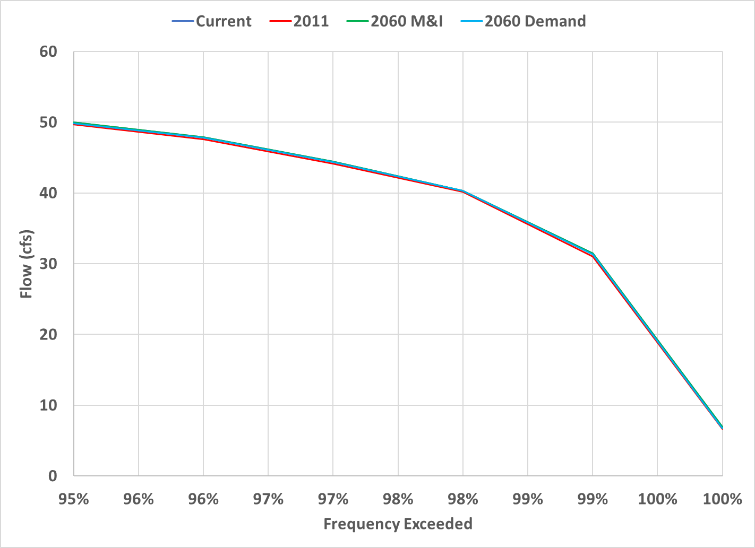
Simulation Results at Reynolds (GA 002072) Location Flow Frequency (low end) 7Q10 = 33.39 cfs
7Q10
Baseline: Average demands 2010-2018
Baseline Drought: 2011 demands
Forecast (ag constant): 2060 demands with ag held constant at baseline
Forecast (ag growth): 2060 demands with ag projected growth

Slide 43
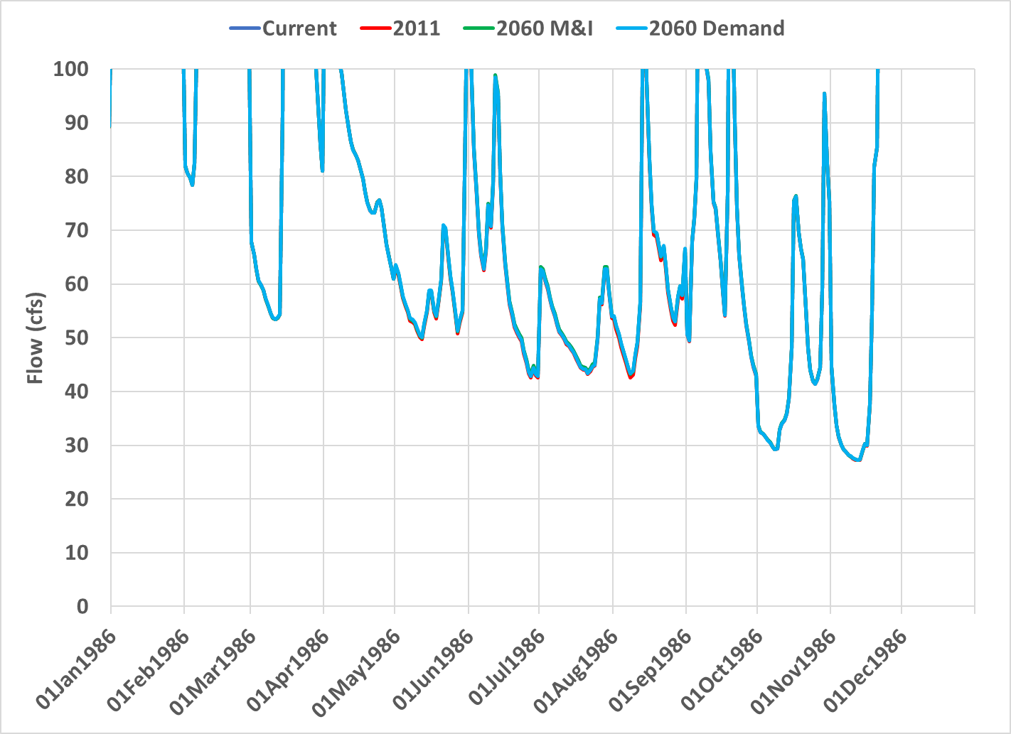
Simulation Results at Reynolds (GA 002072) Location Flow in 1986
7Q10
Baseline: Average demands 2010-2018
Baseline Drought: 2011 demands
Forecast (ag constant): 2060 demands with ag held constant at baseline
Forecast (ag growth): 2060 demands with ag projected growth

Slide 44
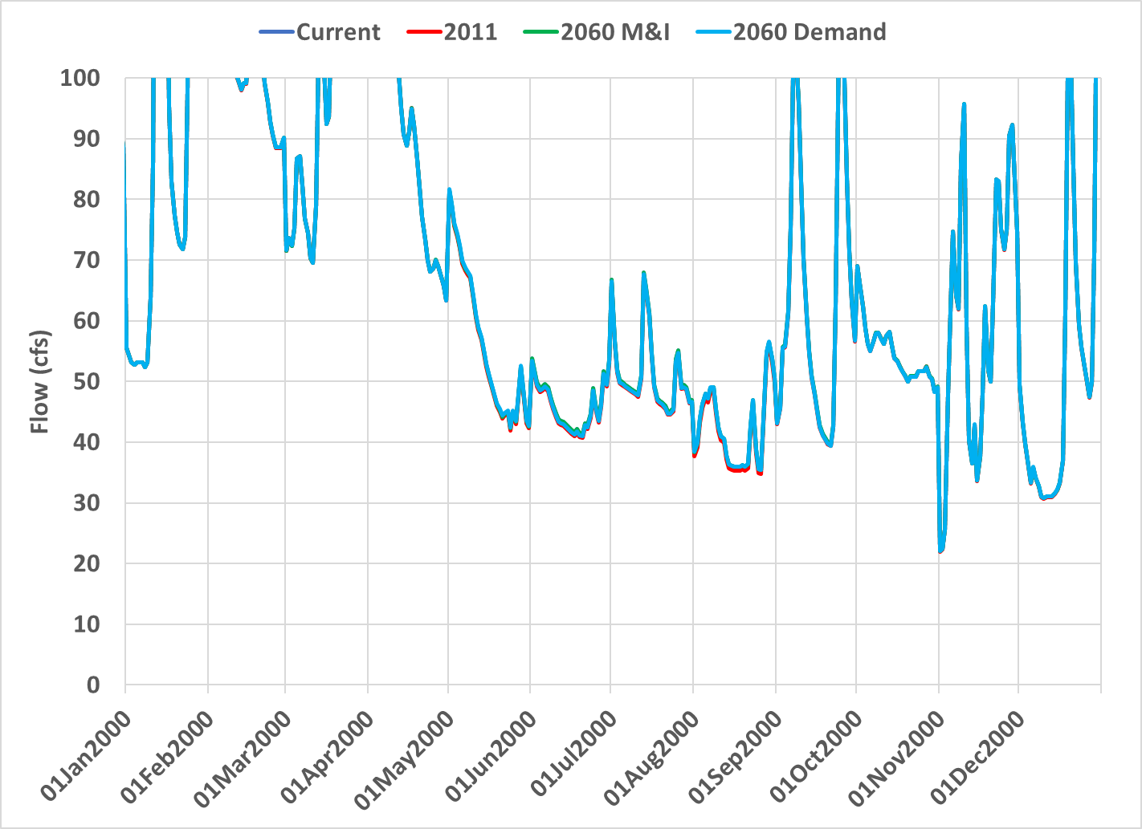
Simulation Results at Reynolds (GA 0020729) Location
Flow in 2000
7Q10
Baseline: Average demands 2010-2018
Baseline Drought: 2011 demands
Forecast (ag constant): 2060 demands with ag held constant at baseline
Forecast (ag growth): 2060 demands with ag projected growth

Slide 45
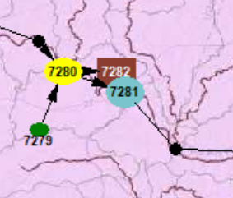
Carsonville Flow Condition
BEAM Node 7281

Slide 46
Simulation Results at Carsonville USGS 02347500 Location Flow in 1986-1988
600 CFS
100 CFS
Baseline: Average demands 2010-2018
Baseline Drought: 2011 demands
Forecast (ag constant): 2060 demands with ag held constant at baseline
Forecast (ag growth): 2060 demands with ag projected growth

Slide 47
Simulation Results at Carsonville (USGS 02347500) Location Flow in 1999-2002
600 CFS
100 CFS
Baseline: Average demands 2010-2018
Baseline Drought: 2011 demands
Forecast (ag constant): 2060 demands with ag held constant at baseline
Forecast (ag growth): 2060 demands with ag projected growth

Slide 48
Simulation Results at Carsonville (USGS 02347500) Location Flow in 2007-2008
600 CFS
100 CFS
Baseline: Average demands 2010-2018
Baseline Drought: 2011 demands
Forecast (ag constant): 2060 demands with ag held constant at baseline
Forecast (ag growth): 2060 demands with ag projected growth

Slide 49
Simulation Results at Carsonville (USGS 02347500) Location Flow in 2011-2012
600 CFS
100 CFS
Baseline: Average demands 2010-2018
Baseline Drought: 2011 demands
Forecast (ag constant): 2060 demands with ag held constant at baseline
Forecast (ag growth): 2060 demands with ag projected growth

Slide 50
Simulation Results at Carsonville (USGS 02341500) Location Flow Frequency
Baseline: Average demands 2010-2018
Baseline Drought: 2011 demands
Forecast (ag constant): 2060 demands with ag held constant at baseline
Forecast (ag growth): 2060 demands with ag projected growth

Slide 51
Simulation Results at Carsonville (USGS 02341500) Location Flow Frequency (low end)
600 CFS
100 CFS
Baseline: Average demands 2010-2018
Baseline Drought: 2011 demands
Forecast (ag constant): 2060 demands with ag held constant at baseline
Forecast (ag growth): 2060 demands with ag projected growth

Slide 52
Simulation Results at Carsonville (USGS 02347500) Location Flow in 1986-1988
600 CFS
Baseline: Average demands 2010-2018
Baseline Drought: 2011 demands
Forecast (ag constant): 2060 demands with ag held constant at baseline
Forecast (ag growth): 2060 demands with ag projected growth

Slide 53
Simulation Results at Carsonville (USGS 02347500) Location Flow in 1999-2002
600 CFS
Baseline: Average demands 2010-2018
Baseline Drought: 2011 demands
Forecast (ag constant): 2060 demands with ag held constant at baseline
Forecast (ag growth): 2060 demands with ag projected growth

Slide 54
Simulation Results at Carsonville (USGS 02347500) Location Flow in 2007-2008
600 CFS
Baseline: Average demands 2010-2018
Baseline Drought: 2011 demands
Forecast (ag constant): 2060 demands with ag held constant at baseline
Forecast (ag growth): 2060 demands with ag projected growth

Slide 55
Simulation Results at Carsonville (USGS 02347500) Location Flow in 2011-2012
600 CFS
Baseline: Average demands 2010-2018
Baseline Drought: 2011 demands
Forecast (ag constant): 2060 demands with ag held constant at baseline
Forecast (ag growth): 2060 demands with ag projected growth

Slide 56
Simulation Results at Carsonville (USGS 02347500) Location Flow Frequency
Baseline: Average demands 2010-2018
Baseline Drought: 2011 demands
Forecast (ag constant): 2060 demands with ag held constant at baseline
Forecast (ag growth): 2060 demands with ag projected growth

Slide 57
Simulation Results at Carsonville (USGS 02347500) Location Flow Frequency
600 CFS
Baseline: Average demands 2010-2018
Baseline Drought: 2011 demands
Forecast (ag constant): 2060 demands with ag held constant at baseline
Forecast (ag growth): 2060 demands with ag projected growth

Slide 58
Carsonville (USGS 02347500)
Simulated Flow Frequency
 | Baseline |  | Baseline Drought |  | Forecast (ag constant) |  | Forecast (ag growth)
Minimum | 63 |  | 53 |  | 77 |  | 81
10 percentile | 350 |  | 346 |  | 349 |  | 351
25 percentile | 651 |  | 642 |  | 627 |  | 630
Median | 1,300 |  | 1,293 |  | 1,284 |  | 1,286
75 percentile | 2,584 |  | 2,581 |  | 2,576 |  | 2,578
90 percentile | 4,687 |  | 4,686 |  | 4,677 |  | 4,678
Maximum | 65,999 |  | 65,994 |  | 65,991 |  | 65,995

Slide 59
Summary
Moderate water supply challenges under baseline and future water use conditions
Moderate wastewater assimilation challenges under baseline and future water use conditions
Reviewed flow results at Carsonville under baseline and future water use conditions
Additional evaluation can be added according to stakeholders’ inputs
Council suggestions for other metrics?

Slide 60
Questions?
Contact Information:
Wei Zeng, Ph.D., Professional Hydrologist
Manager, Water Supply Program
Watershed Protection Branch, Georgia EPD
470-251-4897 (Zoom Phone) New!
470-898-3891 (Cell)
Wei.Zeng@dnr.ga.gov

Slide 61
Small Group Discussion
Small Groups

Slide 62
Small group discussions
What are your primary takeaways from the water availability assessment?
  What implications do they have for you?
Are there any new issues not yet reflected in the recommendations?
  Do the results mesh with the revised plan recommendations?
What else do you want to know about water availability?
  Are there other metrics that you would like to see?
If you had sufficient funds, what water-related projects would you prioritize over the next 5 years?
Discuss any unsettled committee items

Slide 63
Water Quantity Committee Report on revised recommendations
Raines Jordan

Slide 64
Water Quantity Committee
Members: Adam Graft, Gordon Rogers, Teel Warbington, Jack Holbrook, Donald Chase, Raines Jordan, Michael Bowens, Rodney Hilley
Two meetings since last Council meeting:
  June 14, 2022: Discussed draft edits/updates made to the Management Practices in Section 6
  July 25, 2022: Finished discussions on draft edits/updates to the Management Practices and started Recommendations to the State

Slide 65
Key Changes to Water Quantity Related Management Practices
Management Practice​ | Key Change​
DM1 | Modifications to update and add further explanation about suggestions for agricultural water metering.
DM4 | Added advanced irrigation scheduling to management practice for new permits. More details later in this report.
DM5 | Updated description to address current incentive programs for voluntary agricultural water conservation.
SF1 | Modified description to address a full range of reservoir options and cost evaluation. Added a sentence about long-term nature of this management practice. Further discussion planned for this afternoon for coordinated review of reservoir related recommendations in the plan.
SF2 & SF3​ | Updates to describe new ARPA project (alternative groundwater sources for agriculture during drought, aquifer monitoring, habitat conservation planning).
SF4 | Added recommendation for requirement that new surface water withdrawal permits for farm ponds be conditioned such that the withdrawals do not contribute to low flows. More details later in this report.

Slide 66
Key Changes to Water Quantity Related Management Practices
DM4: Implement agricultural water conservation practices in the Upper Flint Water Planning Region
Added the following text in the description:
  “Under the Flint River Drought Protection Act, new withdrawal permits in the Flint River Basin should be required to implement advanced irrigation scheduling (e.g., soil moisture sensors, irrigation scheduling applications).Demonstrating compliance should not be burdensome and could rely on existing self-certification methods for existing efficiency requirements.”
  Any comments from Council?

Slide 67
Key Changes to Water Quantity Related Management Practices
SF4: Encourage greater utilization of new or existing Continue to evaluate farm ponds in the Upper Flint Water Planning Region
  Added the following to the description (based on Suwannee Satilla plan):
  “Future surface water withdrawal permits to fill for farm ponds should be conditioned such that the withdrawals do not contribute to the frequency or severity of low flow conditions in their local drainage areas.”
  Any comments from Council?

Slide 68
Key Changes to Recommendations to the State
Recommendation | Key Change​
IN-4 | Updated to reflect availability of more information to the Council about recharge areas and aquifers.
IN-5 | Added estimation of volume for small withdrawals to recommendation.
IN-7 | Consolidated information need recommendations about small/medium impoundments and farm ponds in this recommendation.
IN-8 | New recommendation about conservation relative to water storage. See next slide for details.
IN-9 | Shortened to reflect improvements in agricultural water meter programs and to cross-reference DM1.
IN-10 | Updated to reflect current focus for conservation assessment. Moved materials about small/medium impoundments to IN-7.
IN-12 | New recommendation about Griffin water supply arrangement with Coweta County. See next slide for details.

Slide 69
Key Changes to Recommendations to the State
Added new Information Need
  IN-8: Conduct a dynamic analysis (under varied management, development, and climatic conditions in the region) to assess how conservation can optimize use of reservoir storage. Consider the results of this analysis when implementing Management Practice SF1 regarding the evaluation of water storage options in the Upper Flint Basin.
  Any comments from Council?

Slide 70
Key Changes to Recommendations to the State
Added new Information Need:
IN-12: Evaluate the cost to buy out the City of Griffin’s water supply contract with Coweta County to improve understanding of the cost-benefit, in terms of dollars and flow impacts, of eliminating the ongoing inter-basin transfer in that supply arrangement. Evaluations should include contextual, seasonal flow improvement in terms of drought flows at affected Upper Flint River Basin gauges, and cost-per-cfs calculations relative to other planned and completed flow-improvement projects throughout the Flint River Basin (Upper and Lower). The Council is not recommending removing the supply pipeline. It should remain in place and be periodically maintained to help assure flexibility and resilience among the connected water providers.
  Any comments from Council?

Slide 71
Summary of Water Quantity Committee Report
Reviewed most of the parts of Section 6 that are relevant to Water Quantity
  Some items for full Council discussion (later this afternoon)
  Additional tweaks may be needed based on BEAM results and Council deliberations
  Next steps:
    Finish review of Water Quantity related Recommendations to the State in Section 6
    Reviewing revisions to Resource Assessment reporting in the plan (Sections 3 and 5)

Slide 72
Water Quality Committee Report on Revised Recommendations
Beth English

Slide 73
Water Quality Committee
Members: Barry Blount, Beth English, Brant Keller, Lamar Perlis,
Butch Turner, Joel Wood
Meeting on June 22, 2022
  Discussed draft edits/updates made to the Management Practices in Section 6
Meeting on August 11, 2022
  Discussed draft edits/updates made to the Recommendations to the State in Section 6

Slide 74
Key Changes to Water Quality Related Management Practices
Management Practice | Key Change
WQ2: Improve implementation of nonpoint source controls | Added language on implementation of BMPS Added language from WQ3 on encouraging implementation of stream buffers for all land uses and includes language on incentivizations and increased Section 319 grant funds.
WQ3: Increase education directed toward improving water quality | Added language for encouraging education concerning groundwater quality
WQ5: Utilize technology to improve water quality management information | Revised and updated to include language on the utilization of resources that have been made available for collection, coordination and utilization of water quality data.

Slide 75
Key Changes to Water Quality Related Recommendations
Recommendations to the State:
WP-7: Recommends legislation of authority to the regional planning councils
  Quality subcommittee discussed that having “Authority” would require staff and money and commitment.
  Input needed from Council
WP-8: Development of tristate framework
  Similarly to WP-7, the Quality subcommittee discussed that a tristate authority would require resources, time, money, staff, and other states buy-in.
  Input needed from Council

Slide 76
Inter-Council Coordination Committee Report on Revised Joint Recommendations
Donald Chase

Slide 77
Inter-Council Coordination Committee
Lower Flint - Ochlockonee
Jay Smith
Jimmy Webb
Middle Chattahoochee
Harry Lange
Upper Flint
Donald Chase
Patrick Bowie
Hugh Dollar

Slide 78
Inter-Council Coordination Committee Report
Meeting on June 23, 2022
Reviewed and Discussed 2017 “Coordinated Recommendations with Neighboring Councils” in Section 6
Made Updates and Revisions
Select representative to present at August council meeting

Slide 79
Inter-Council Coordination Committee
JT-1
JT-2
Unedited
Edited
Recognize the critical need for better use of existing storage and for more storage in the Apalachicola-Chattahoochee-Flint (ACF) System and recommend that a plan for additional storage be developed and implemented and that it consider the following: better utilization of existing storage in the Chattahoochee River Basin, new storage in the Flint River Basin, and enhancement of existing storage capacity.
Urge EPD and those involved in the resource assessment modeling to continue to improve upon existing models for future regional water planning by further expanding use of actual and current data on water use and conditions and by continuing to refine assumptions that more closely approximate actual conditions.

Slide 80
Inter-Council Coordination Committee
JT-3
Unedited
JT-4
New
Consider the creation of a new coordinated, interstate planning organization for the ACF System. Membership in this organization to represent Georgia shall include, but not be limited to, members of the regional water planning councils with water planning regions that include parts of the ACF. Consider the recommendation of the ACF Stakeholders in its Sustainable Water Management Plan regarding an ACF transboundary water management institution as this organization is developed.
Recognize the need for identifying contributors that diminish water quality. Continue to develop methods, guidelines, and BMPs to improve water quality, and continue to educate on these BMPs.

Slide 81
Council Discussion

Slide 82
Council Discussion
Report from Break-Out Groups
Issues for Council Input/Discussion:
  Recommendation about council role/authority
  Recommendations about interstate coordination/planning/conflict management
  Recommendations about water storage
Other topics from the Council?

Slide 83
Recommendation WP-7 Addressing the Role/Authority of the Council
WP-7: The Council recommends that the Georgia General Assembly legislate authority to the regional water planning councils, including the Upper Flint Water Planning Council, to manage, plan and provide oversight of water resources within each region around the State. Funding should be provided to the councils from State appropriations. Funding should be used to provide for coordination and implementation of regional and state water plans and for studies, assessments and future plan updates within the respective water planning regions.
Notes:
Because this recommendation addresses an over-arching management issue, we wanted to bring it up for full Council review and discussion. This recommendation has been the focus of some in-depth Council discussions in the past. The Water Quality committee flagged it for full Council discussion. Maybe ask the committee members to comment on their views on this recommendation.
MC Council is also discussing this issue (on 8/22 MC Council will be asked to confirm their decision to delete a similar recommendation from their plan, based Council discussion at May meeting).
What do the Council members think? Is this still the Council’s view? Does anyone want to suggest any updates or modifications?

Slide 84
Recommendations WP-8 and JT-3 Addressing Interstate Coordination in ACF
WP-8: The Council urges the State to seek a timely resolution of current interstate water issues that directly affect the Apalachicola-Chattahoochee-Flint Basin. The Council recommends the development of a tristate framework designed to address interstate water issues in the future and the inclusion of the regional water planning councils within this framework. The Council requests that it be supported in making any updates to this Regional Water Plan as needed to address changes in ACF Basin management as a result of the settlement, resolution, or decision in on-going inter-state litigation or similar events that have the potential to substantially change how the Basin is managed.
JT-3: Consider the creation of a new coordinated, interstate planning organization for the ACF System. Membership in this organization to represent Georgia shall include, but not be limited to, members of the regional water planning councils with water planning regions that include parts of the ACF. Consider the recommendation of the ACF Stakeholders in its Sustainable Water Management Plan regarding an ACF transboundary water management institution as this organization is developed.
Notes:
Two recommendations in Section 6 address interstate coordination in the ACF. Because this is a broad issue in the plan, we wanted to bring it up for full Council review and discussion. We would like to hear your thoughts on these recommendations. Are you comfortable with them? Are they consistent? Should we modify one or both of them? Does anything need updating?
[Any changes to JT-3 from LFO or MC to discuss?]
[Concern raised by a LFO member that JT-3 should not recommend an interstate institution with management authority. Any clarification of this language?]
If needed – Mark should be able to describe the ACFS work on transboundary institutions.
For Joint 3: You could suggest that a sentence be added at the end to clarify that the Council supports an organization for planning and coordination, but not one that would have interstate management authority over water resources.
Note that edits to joint recommendations (JT-3 here) need to be reviewed by all 3 Councils.

Slide 85
Items in Plan Addressing Water Storage
Mgmt Practice/ Recommendation | Key Change​
SF1 | Evaluate storage options in the Upper Flint River Basin that can provide for supply and flow augmentation in dry periods (see plan for more details)
SF4 | Continue to evaluate farm ponds in the Upper Flint Water Planning Region (see plan for more details)
IN-7 | Evaluate the full water cycle impacts of irrigation and the impacts of small and medium impoundments on stream flows through intercepted drainage, evaporative loss, and water quality. GAEPD has advanced the understanding of how farm ponds are used in Georgia and how to incorporate them into the surface water availability resource assessment. However, better understanding of farm pond operation and impacts is needed to support more thorough evaluation. In particular, a better understanding of the impact of evaporative loss is needed.
IN-8 | Conduct a dynamic analysis (under varied management, development, and climatic conditions in the region) to assess how conservation can optimize use of reservoir storage. Consider the results of this analysis when implementing Management Practice SF1 regarding the evaluation of water storage options in the Upper Flint Basin.
JT-1​ | Recognize the critical need for better use of existing storage and for more storage in the Apalachicola-Chattahoochee-Flint System and recommend that a plan for additional storage be developed and implemented and that it consider the following: better utilization of existing storage in the Chattahoochee River Basin, new storage in the Flint River Basin, and enhancement of existing storage capacity.
Notes:
Water Quant committee asked that the Council discuss reservoirs and water storage recommendations. In particular, a committee member asked: How should we approach storage options given increasing population? Other committee members expressed some concerns about storage. Here are the Management Practices and Recommendations that address water storage in the plan in one place so that Council can consider them together. Are they consistent? Do they reflect the Council’s views, vision, and goals? Any modifications or updates needed?

Slide 86
Public Comment

Slide 87
Next Steps
Meagan Szydzik

Slide 88
Next Steps
Next Meeting: December 2nd – Plan Review of Sections 3 & 5
Committees to work on plan revisions
  Water Quantity and Water Quality

Slide 89
Thank You
Upper Flint

Slide 90
Facilities having water supply challenge
(unit: million gallon)
BEAM Node |  | 4525 | 6825 | 6884 | 6885 | 7045 | 7195 | 7555
Permit No. |  | 072-1224-02 | 038-1102-05 | 099-1106-04 | 099-1106-07 | 130-1106-05 | 145-1105-03 | 133-1109-01
Permit Holder |  | Pine Mountain Valley Water Association | City Of Senoia | Roosevelt Warm Springs Institute | City of Warm Springs | City of Manchester | City Of Thomaston | Covia Financial Corporation
Challenge days | Baseline | 17(0.06%) | 1430(4.89%) | 106(0.36%) | 6(0.02%) | 4629(15.84%) | 911(3.12%) | 25(0.09%)
(percentage) | Baseline_2011 | 16(0.05%) | 1278(4.37%) | 44(0.15%) | 0(0.00%) | 4659(15.94%) | 969(3.32%) | 26(0.09%)
 | Future_2060M&I | 17(0.06%) | 1429(4.89%) | 336(1.15%) | 81(0.28%) | 2773(9.49%) | 726(2.48%) | 25(0.09%)
 | Future_2060M&I_2060AG | 17(0.05%) | 1429(4.89%) | 336(1.15%) | 81(0.28%) | 2773(9.49%) | 670(2.29%) | 25(0.09%)
Total volume of shortage | Baseline | 0.97 | 283.12 | 10.84 | 0.08 | 3762.47 | 1584.22 | 10.67
(million gallon) | Baseline_2011 | 0.71 | 231.62 | 2.97 | 0.00 | 3830.49 | 1641.87 | 17.11
 | Future_2060M&I | 0.98 | 282.54 | 67.63 | 12.08 | 906.79 | 815.52 | 10.43
 | Future_2060M&I_2060AG | 0.98 | 282.54 | 67.63 | 12.08 | 906.79 | 737.66 | 9.73
Total volume of shortage | Baseline | 0.00 | 38.41 | 3.38 | 0.03 | 326.00 | 354.97 | 0.00
in 2007-2008(million gallon) | Baseline_2011 | 0.00 | 33.72 | 1.19 | 0.00 | 331.15 | 379.44 | 0.00
 | Future_2060M&I | 0.00 | 38.34 | 15.20 | 3.93 | 100.03 | 202.37 | 0.00
 | Future_2060M&I_2060AG | 0.00 | 38.34 | 15.20 | 3.93 | 100.03 | 189.03 | 0.00
Total volume of shortage | Baseline | 0.00 | 60.84 | 3.66 | 0.03 | 426.01 | 300.63 | 0.00
in 2011-2012(million gallon) | Baseline_2011 | 0.00 | 51.87 | 1.15 | 0.00 | 433.56 | 326.84 | 0.00
 | Future_2060M&I | 0.00 | 60.74 | 13.90 | 4.53 | 129.07 | 146.37 | 0.00
 | Future_2060M&I_2060AG | 0.00 | 60.74 | 13.90 | 4.53 | 129.07 | 141.56 | 0.00

Slide 91
Facilities having Wastewater Assimilation Challenge (unit: million gallon)(1)
BEAM Node |  | 6798 | 6878 | 7218 | 7318 | 7498 | 7618
Permit No. |  | GA0025470 | GA0001601 | GA0020079 | GA0020729 | GA0000302 | GA0023710
Permit Holder |  | City of Concord(South WPCP) | City ofWarm Springs(Warm Springs WPCP) | City ofThomaston(Bell Creek WPCP) | City of Reynolds(Reynlds WPCP) | Taylor County Board of Commissionners (Plant Laurel WPCP) | City of Buena Vista(Buena Vista WPCP)
7Q10 Flow (cfs) |  | 3.76 | 0.64 | 13.47 | 33.39 | 4.86 | 1.29
Challenge days | Baseline | 715(2.45%) | 309(1.06%) | 580(1.98%) | 332(1.14%) | 79(0.27%) | 1(0.00%)
(percentage) | Baseline_2011 | 781(2.67%) | 216(0.74%) | 669(2.29%) | 337(1.15%) | 94(0.32%) | 1(0.00%)
 | Future_2060M&I | 715(2.45%) | 461(1.58%) | 468(1.60%) | 332(1.14%) | 79(0.27%) | 1(0.00%)
 | Future_2060M&I_2060AG | 658(2.25%) | 461(1.58%) | 428(1.46%) | 336(1.15%) | 82(0.28%) | 1(0.00%)
Total volume of shortage | Baseline | 836.30 | 75.56 | 1380.05 | 2023.82 | 92.21 | 0.00
(million gallon) | Baseline_2011 | 976.95 | 44.72 | 1904.81 | 2074.75 | 117.39 | 0.00
 | Future_2060M&I | 836.30 | 147.14 | 1003.32 | 2023.82 | 92.21 | 0.00
 | Future_2060M&I_2060AG | 762.07 | 147.14 | 824.60 | 2041.91 | 100.45 | 0.00

Slide 92
Facilities having Wastewater Assimilation Challenge (unit: million gallon)(2)
BEAM Node |  | 7728 | 7768 |  | 7848 | 7878 | 7978
Permit No. |  | GA0025623 | GA0024503 |  | GA0050105 | GA0047767 | GA0020931
Permit Holder |  | Town of Byromville(Byromville WPCP) | City of Cordele (Gum Creek WPCP) |  | City of Ellaville(Ellaville WPCP) | City of Ellaville(Ellaville WPCP) | City of Ellaville(Ellaville WPCP)
7Q10 Flow (cfs) |  | 2.85 | 2.56 |  | 0.03 | 10.54 | 0.11
Challenge days | Baseline | 2466(8.44%) | 756(2.59%) |  | 15(0.05%) | 209(0.72%) | 0(0.00%)
(percentage) | Baseline_2011 | 4670(15.98%) | 1289(4.41%) |  | 37(0.13%) | 926(3.17%) | 2(0.01%)
 | Future_2060M&I | 2466(8.44%) | 756(2.59%) |  | 15(0.05%) | 208(0.71%) | 0(0.00%)
 | Future_2060M&I_2060AG | 5313(18.18%) | 1406(4.81%) |  | 32(0.11%) | 334(1.14%) | 0(0.00%)
Total volume of shortage | Baseline | 1715.97 | 1460.29 |  | 1.05 | 656.58 | 0.00
 | Baseline_2011 | 4589.51 | 2604.46 |  | 1.00 | 4422.55 | 0.29
(million gallon) | Future_2060M&I | 1713.05 | 1435.98 |  | 2.32 | 638.16 | 0.00
 | Future_2060M&I_2060AG | 5923.75 | 2965.33 |  | 5.05 | 1358.59 | 0.00

Slide 93
Carsonville Flow Summary
Scenario |  | Baseline | Baseline_2011 | Future_2060M&I | Future_2060M&I_2060AG
Daily flow <100 cfs | Days | 77 | 127 | 13 | 10
 | Percentage | 0.264% | 0.435% | 0.044% | 0.034%
Daily flow <600 cfs | Days | 6609 | 6723 | 6913 | 6886
 | Percentage | 22.618% | 23.008% | 23.658% | 23.566%
Notes:
1. USGS gage 02347500 had 103 days of flow less than 100 cfs for the 2011-2012 period.

Slide 94
Summary of USGS 02341500 Location simulated
Flow Frequency
Scenario | Baseline | Baseline_2011 | Future_2060M&I | Future_2060M&I_2060AG
Minimum | 63 | 53 | 77 | 81
10 percentile | 350 | 346 | 349 | 351
25 percentile | 651 | 642 | 627 | 630
Median | 1300 | 1293 | 1284 | 1286
75 percentile | 2584 | 2581 | 2576 | 2578
90 percentile | 4687 | 4686 | 4677 | 4678
Maximum | 65999 | 65994 | 65991 | 65995

