Slide 1
Upper Flint
Council Meeting
Upper Flint
December 2, 2022
waterplanning.georgia.gov

Slide 2
Introductions
DONALD CHASE
Council Chair for:
Upper Flint
dgmkchase@gmail.com
(478) 472-7726
KRISTIN ROWLES
GWPPC
Council Lead for:
Upper Flint
krowles@h2opolicycenter.org
(404) 822-2395
MARK MASTERS
GWPPC
JOHANNA SMITH
Georgia EPD
Council Advisor for:
Upper Flint
mmasters@h2opolicycenter.org
Liaison for:
Upper Flint
Johanna.Smith@dnr.ga.gov
(470) 632-3158
STEPHEN SIMPSON
Black & Veatch
MEAGAN SZYDZIK
GWPPC
Council Advisor for:
Upper Flint
mszydzik@h2opolicycenter.org
(770) 543-8497
Council Advisor for:
Upper Flint
simpsonsl@bv.com
(770) 521-8105
CORINNE VALENTINE
Black & Veatch
Council Advisor for:
Upper Flint
valentinec@bv.com
(770) 752-5256
COURTNEY COOPER
GWPPC
Council Advisor for:
Lower Flint-Ochlockonee
ccooper@h2opolicycenter.org
JASON HOWARD
Black & Veatch
Council Advisor for:
Upper Flint
howardje@bv.com
(770) 521-8133

Slide 3
Upper Flint Council Members
Name | City | County
Brian Belcher | Ellaville | Schley
Barry Blount | Americus | Sumter
Michael Bowens | Vienna | Dooly
Gene Brunson | Reynolds | Taylor
Thomas Burnsed | Meansville | Pike
Donald Chase, Chair | Oglethorpe | Macon
Brad Ellis | Vienna | Dooly
Beth English | Vienna | Dooly
Steve Fry | Williamson | Pike
Adam L. Graft | Americus | Sumter
Rodney H. Hilley | Molena | Pike
Jack Holbrook (Alternate) | Preston | Webster
Terrell Hudson | Unadilla | Dooly
Raines Jordan, Vice Chair | Talbotton | Talbot
Bob Melvin | Oglethorpe | Macon
Kenneth L. Murphy | Gay | Meriwether
Sen. Ed Harbison (Ex-Officio)
Name | City | County
Lamar Perlis | Cordele | Crisp
Gary Powell | Buena Vista | Marion
Jim Reid | Americus | Sumter
Gordon Rogers | Talbotton | Talbot
Charles Rucks | Brooks | Spalding
Bill Sawyer | Ellaville | Schley County
Walter E. (Butch) Turner | Reynolds | Taylor
Brian Upson | Griffin | Spalding
George (Teel) Warbington (Alternate) | Vienna | Dooly
Rodney Wilson | Zebulon | Pike
Benjamin (Joel) Wood | Cordele | Crisp
Ben Haugabook |  | Macon

Slide 4
Chair’s Report
Presented by Chairman Chase

Slide 5
Summary from Last Meeting
Courtney Cooper

Slide 6
August 24 Meeting Overview
Reviewed surface water availability assessment results
Reviewed revisions to management practices and recommendations
Considered revisions to recommendations from Plan Review & Inter-Council Coordination Committees

Slide 7
Surface Water Quality Assessment Results
Corinne Valentine & Steve Simpson

Slide 8
How This Presentation Relates to the Plan
Section 3.2.3 – Surface Water Quality
  Covers existing water quality
Section 3.3.1 - 303(d) List and TMDLs
  Documents assessed stream segments meeting/not meeting designated uses
Section 5.3 Surface Water Quality
  Compares current and future projected differences in water quality
Section 6.2 – Selected Water Management Practices
  WQ1 through WQ-5
Section 6.3 Recommendations to the State
  IN-1, IN-11, WP-1
Notes:
Water quality equally important to water quantities. Council members recommend management practices aimed at improving water quality to ensure council goals are met

Slide 9
Water Quality Overview
Impaired Waters Identification (305(b)/303(d) list
  Based on actual water quality test data from specific stream reaches
  Addressed by Total Maximum Daily Loads and Implementation Plans
Dissolved Oxygen Modeling (Assimilative Capacity)
  Calculated under low flow, high water temperature, maximum permit flows and limits
  Future conditions evaluated with revised permit limits
Watershed Modeling
  Current conditions calibrated based on water quality test data
  Future conditions projected based on land use changes
Notes:
Water quality equally important to water quantities. Council members recommend management practices aimed at improving water quality to ensure council goals are met

Slide 10
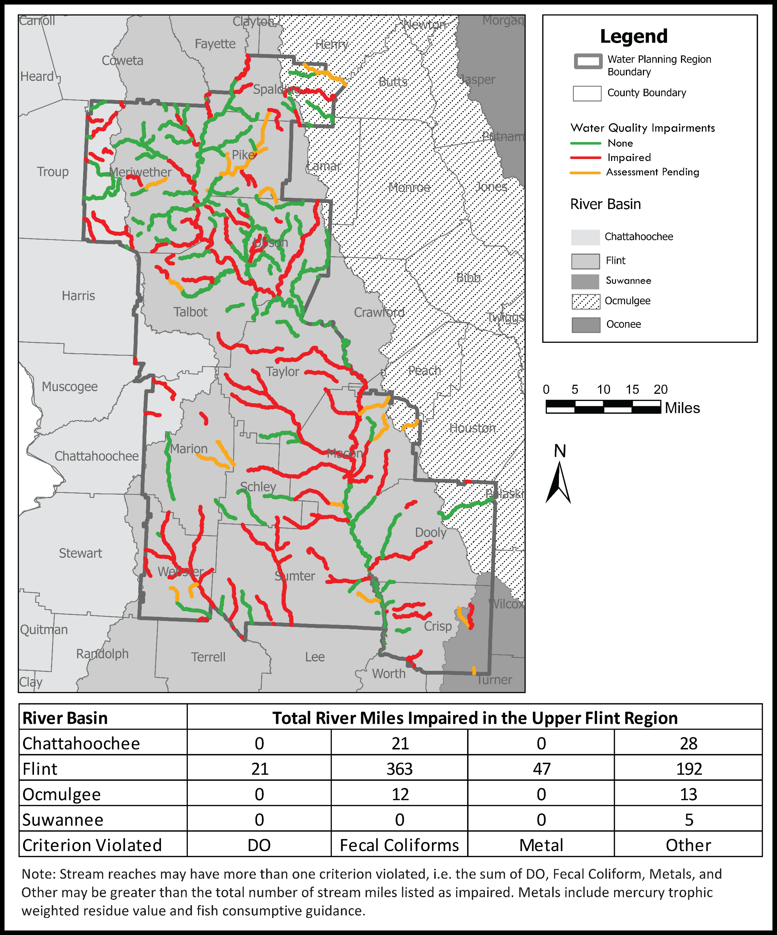
Upper Flint Impaired Stream Segments
Notes:
Water quality equally important to water quantities. Council members recommend management practices aimed at improving water quality to ensure council goals are met

Slide 11
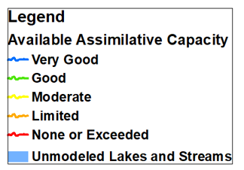
Dissolved Oxygen Modeling
Current Conditions
  2019 Permit Limits
Future Conditions
  2060 Assumed Permit Limits
DOSAG and Riv-1 Models:
  High temp, low flow conditions
Assimilative Capacity
  How DO levels compare to water quality standard of 5.0 mg/L (or natural conditions)
Notes:
Very good (blue) – 1.0 mg/L or more over the std
Good -

Slide 12
DO Conditions: Upper Flint Basin
Current Conditions
Future Conditions
SPALDING
SPALDING
PIKE
PIKE
MERIWETHER
MERIWETHER
UPSON
UPSON
TALBOT
TALBOT
Notes:
Ask Liz for input on this

Slide 13
DO Conditions: Middle Flint Basin
Current Conditions
Future Conditions
TAYLOR
MACON
MARION
SCHLEY
DOOLY
WEBSTER
SUMTER
CRISP

Slide 14
DO Conditions: Lower Flint Basin
Current Conditions
Future Conditions

Slide 15
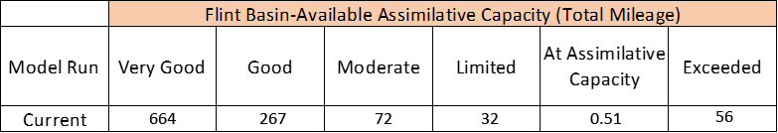
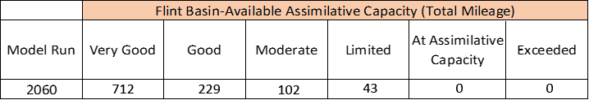
Assimilative Capacity Total Stream Miles
Current Conditions
Future Conditions

Slide 16
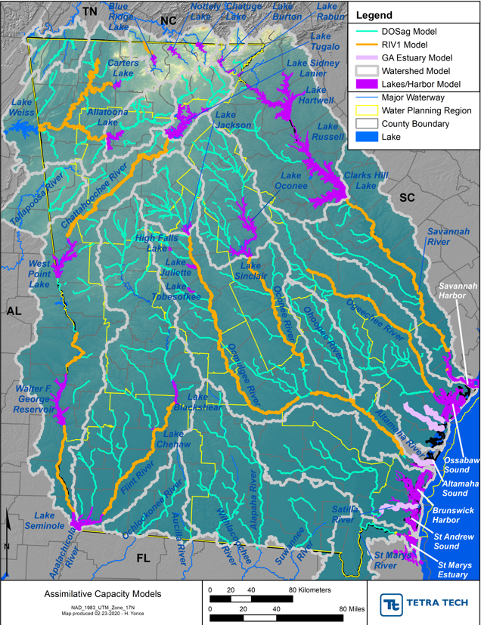
Watershed Modeling
Model updates are underway
Notes:
The watershed models are also calibrated to temperature, salinity and DO data collected from 2001 through 2012

Slide 17
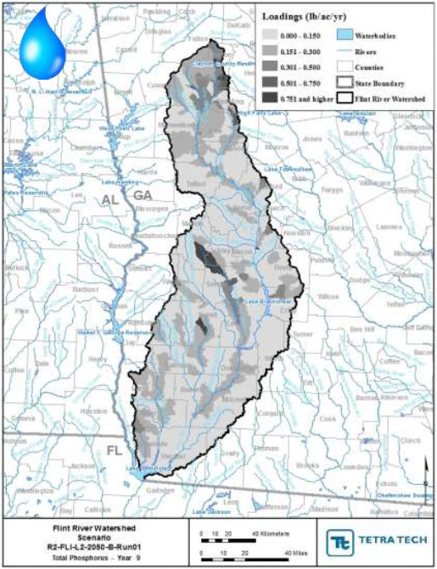
Watershed Modeling: Nutrients
Current (2008) and future (2050) landuse
Meteorological information (2001-2012)
Point Source Discharges
  Current 2014, Future 2050
Heat maps
  Loadings – by subbasin – under representative wet and dry years
  Total Nitrogen
  Total Phosphorus
Increases under dry year conditions
  Point source-driven
Increases under wet year conditions
  Nonpoint source-driven (land uses)
Notes:
The watershed models are also calibrated to temperature, salinity and DO data collected from 2001 through 2012

Slide 18

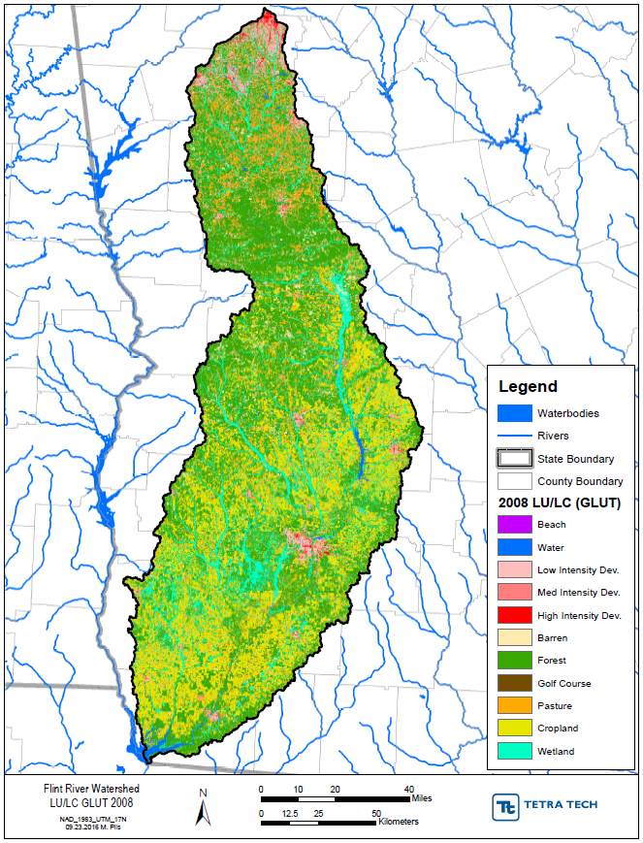

FLINT LAND USE CHANGES (2008-2050)
DEPARTMENT OF NATURAL RESOURCES
Notes:
This figures shows an example of the land use use changes from 2008 to 2050 anticipated in the lower Altamaha River Basin. To see the projected landuse changes in each river basin you can look in your packet which includes both figures and a the table that provides the percent of each land use type for each basin in 2008 and 2050. The last two columns are is the percent breakdown by land use types for the entire basin area in 2008 and 2050.

Slide 19
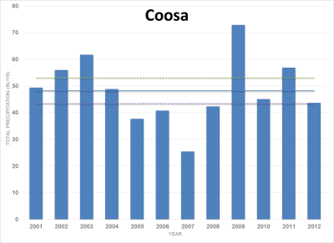
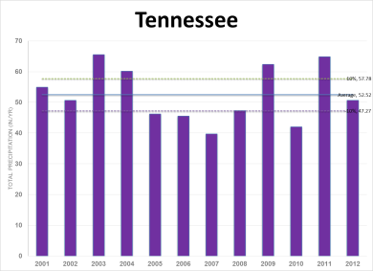
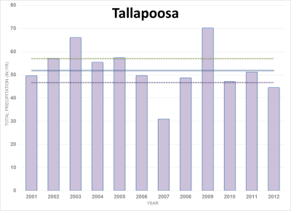
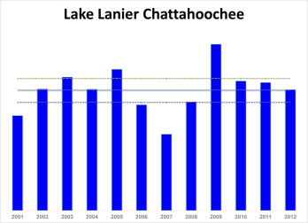
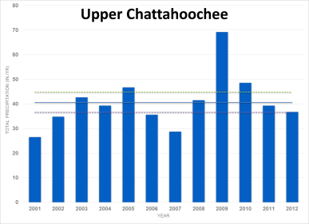
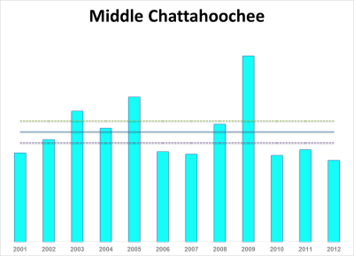
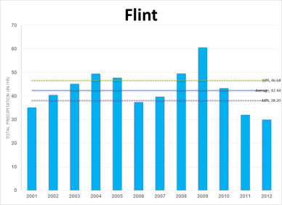
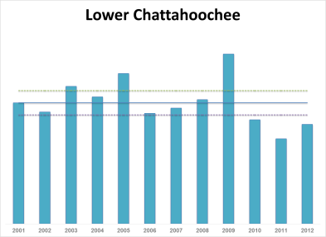
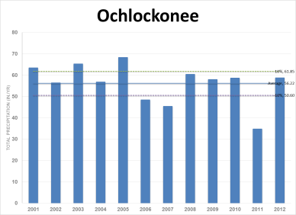
BASIN RAINFALL ANALYSIS
Basin | Wet | Dry
Ochlockonee | 2005 | 2011
Flint | 2009 | 2012
Lanier Chattahoochee | 2009 | 2007
Upper Chattahoochee | 2009 | 2001
Middle Chattahoochee | 2009 | 2012
Lower Chattahoochee | 2009 | 2011
Tallapoosa | 2009 | 2007
Coosa | 2009 | 2007
Tennessee | 2003 | 2007
DEPARTMENT OF NATURAL RESOURCES

Slide 20
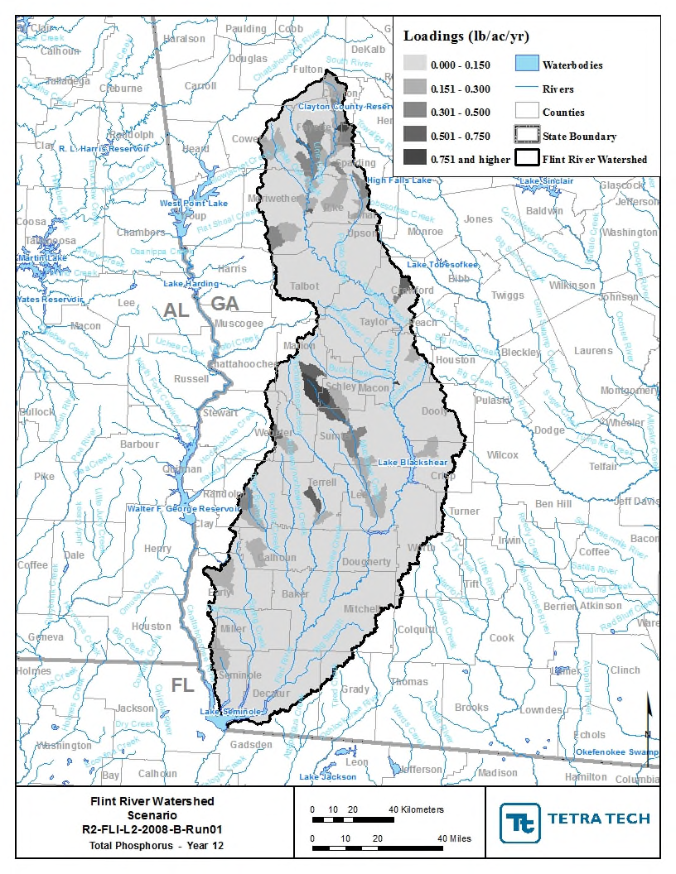

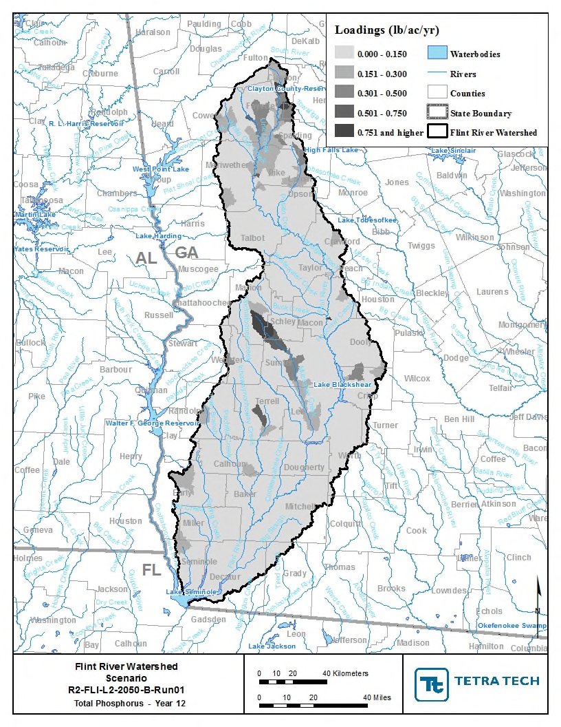
COMPARISON OF CURRENT AND FUTURE
WATERSHED MODEL HEAT LOADS
DEPARTMENT OF NATURAL RESOURCES

Slide 21
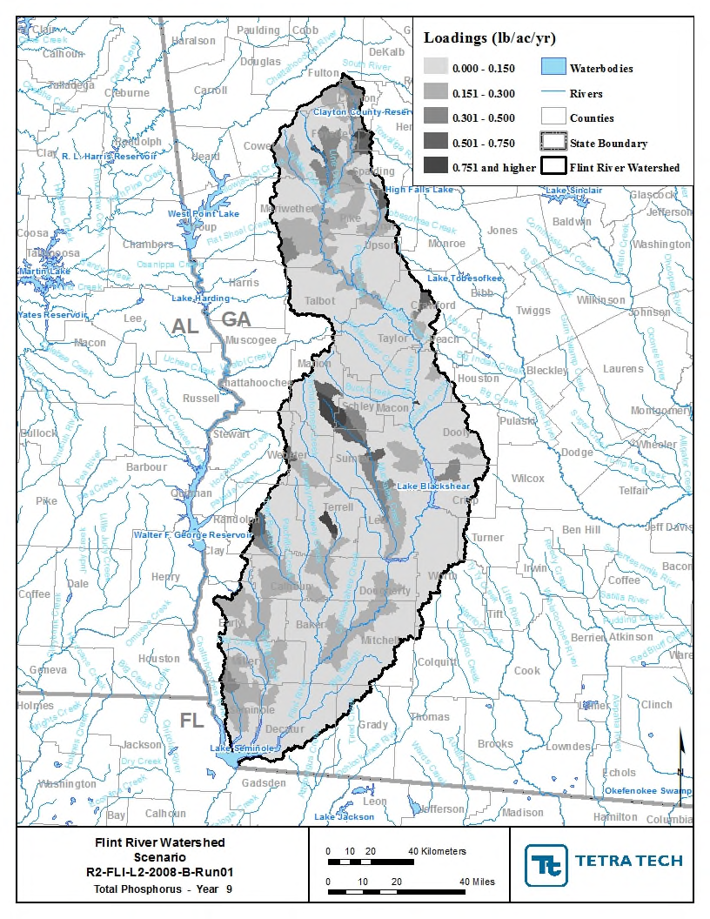
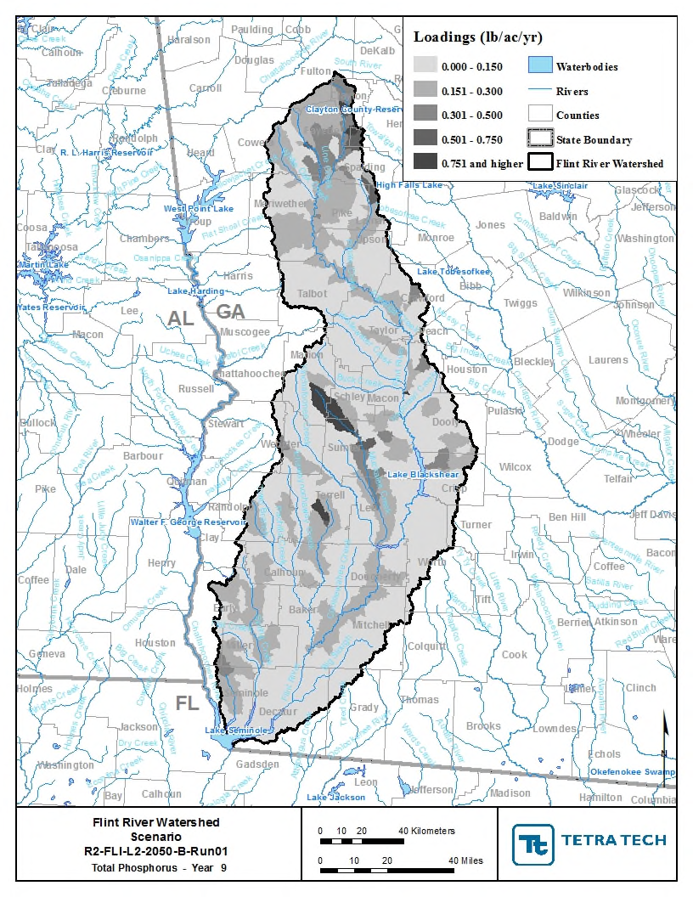

COMPARISON OF CURRENT AND FUTURE
WATERSHED MODEL HEAT LOADS
DEPARTMENT OF NATURAL RESOURCES

Slide 22
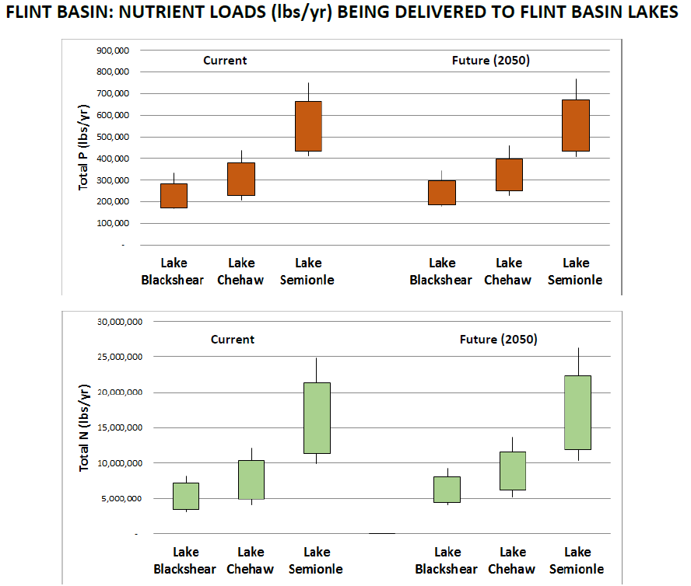
Lake Modeling: Chlorophyll a
Plan Sections 3.2.3 and 5.3
Lake models predict the algal response (chlorophyll a) to nutrient loads from the watershed models
There are currently no applicable chlorophyll a lake standards
Notes:
Note different in scale (total N loads much higher)
Lakes Chehaw and Seminole are downstream of the Upper Flint region
Increases in Total N are nonpoint source driven, whereas increases in Total P are point source driven

Slide 23
COMPARISON OF CURRENT AND FUTURE LAKE
GROWING SEASON AVERAGE NUTRIENT LEVELS
 | Scenario | Lake Chehaw/Worth | Lake Seminole
Total N (mg/L) | Current NPS | 1.08 | 0.82
 | Current PS + NPS | 2.05 | 1.42
 | 2050 NPS | 1.10 | 0.89
 | 2050 PS +NPS | 2.20 | 2.21
Total P (mg/L) | Current NPS | 0.058 | 0.046
 | Current PS + NPS | 0.173 | 0.079
 | 2050 NPS | 0.060 | 0.048
 | 2050 PS + NPS | 0.195 | 0.088
No numeric nutrient criteria for Lakes Blackshear, Chehaw/Worth, and Seminole, but lake standards will be developed in the future
Lake Blackshear Max Total N (under Current and Future Permit conditions) did not exceed 4 mg/L
Lake Chehaw/Worth Max Total N (under Current Permit conditions) 4.6 mg/L
Florida Lake Seminole Criteria - 1.27-2.23 mg/L Total N and 0.05-0.16 mg/L Total P
  Max Total N at Dam Pool current conditions 1.06 mg/L , future conditions 2.80 mg/L
  Max Total P at Dam Pool current conditions 0.126 mg/L, future conditions 0.111 mg/L
DEPARTMENT OF NATURAL RESOURCES
Notes:
The maximum annual growing season average total N and Total P levels predicted for the various scenarios are shown here. Lake Jackson has a Total N criteria not to exceed 4.0 mg/L in the photic zone, The model predicts a max Total N level of 6.7 mg/L based on the current permits. We need to determine if we need to change the criteria to include a duration and frequency such as a growing season average standard and and we will have to manage the lake watershed to ensure this criterion is meet. We do not currently have nutrient standards for Lake Oconee and Lake Sinclair, but we will be working on that going forward, and the information included in your handout materials regarding modeled chlorophyll levels in those lakes will be important to that analysis.

Slide 24
Watershed Modeling: Nutrients
Current Conditions addressed in Plan Section 3.2.3
Nutrients
“Watershed and lake models were run assuming current levels of water use and wastewater disposal and current land use profiles as inputs. These inputs accounted for nutrient loading from the contributing watershed over twelve years of recently observed hydrology. The model results indicated that in the Flint River Basin, nonpoint sources currently contribute, in general, more total nitrogen than point sources, whereas point sources contribute more total phosphorus than nonpoint sources.
. . .
One lake in the Upper Flint Water Planning Region was modeled: Lake Blackshear. The
results indicated that in Lake Blackshear, current total phosphorus loading is primarily from point sources. At this time, nutrient standards have not been established for Lake Blackshear, and therefore, these results cannot be compared against nutrient standards. However, the results indicate how nutrient control efforts should be directed to manage current and future nutrient loading.”

Slide 25
Watershed Modeling: Nutrients
Future Conditions addressed in Plan Section 5.3
“Watershed and lake models were also run at future (2050) conditions. The model results indicated that in the Flint River Basin, while nonpoint sources currently contribute more total nitrogen than point sources, future increases in total nitrogen loading will come more from point sources than nonpoint sources. The lake model results indicated that in Lake Blackshear, total phosphorus loading in the future will be primarily from point sources, as it is under current conditions.
. . .
As noted in Section 3.3, these lakes do not have established nutrient standards, and so, the lake model results cannot be compared against standards for these lakes. However, the model results are an indication of where management practices should be directed in order to control nutrient loading.”

Slide 26
Water Quality Committee Report
Presented by Barry Blount

Slide 27
Water Quality Committee: October Meeting
Meeting on October 17, 2022
Review and discuss Section 3 – Current Conditions
Review and discuss Section 5 – 2060 Projected, time permitting
Select representative to present at today’s council meeting
Members: Barry Blount, Beth English, Lamar Perlis,
Butch Turner, Joel Wood, Brandon Lewis

Slide 28
Key Changes to Water Quality
Section 3 Current Conditions
River Model (Dissolved Oxygen Modeling)
  AKA Assimilative Capacity. Assimilative capacity evaluates how DO levels compare to water quality standard of 5.0 mg/L (or natural conditions).
  Dr. Liz Booth (EPD) presented these in May
  Updated municipal and industrial wastewater facilities operating at their full permitted discharge levels (flow and effluent discharge limits with 2019 values
Lake and Watershed Models (Nutrient Modeling)
  This data has not been updated, and we will not get an update prior to the RWP report update. Only the language was updated.
303(d) list
  Streams not supporting designated uses, and Total Maximum Daily Load (TMDL) which addresses these pollutants
  Updated with 2022 data. Revised from stream quality number to simpler (Impaired, none, pending)

Slide 29
Key Changes to Water Quality
Section 5 Future Conditions
River Model (Dissolved Oxygen Modeling)
  Dr. Liz Booth (EPD) presented these in May
  Updated to 2060 (from 2050). Improved language for clarity
  Assumptions in permitting show the DO improving from current because of planned changes to wastewater discharge permits becoming more stringent as permittees update permits
Lake and Watershed Models (Nutrient Modeling)
  This data has not been updated, and we will not get an update prior to the RWP report update. Only the language was updated.

Slide 30
Water Quality
Discussion
River Model (Dissolved Oxygen Modeling)
  Request for Point source discharge location in the Assimilative Capacity Figure
  Add discussion on why Assimilative capacity will improve
303(d)
  Request percentage of impaired streams add by info added as to impaired stream miles, by impairment type (like 2017 version)
Additional Discussion
  Request discharge limits from EPD
  Non-point and stormwater affects on stream quality (bioto/sediment) versus direct discharge. Team discussed that section 6 includes discussion on management practices and recommendations to the state

Slide 31
Surface Water Quantity Assessment Results Update
Kristin Rowles & Wei Zeng

Slide 32
Water Quantity Committee Report
Presented by Adam Graft

Slide 33
Water Quantity Committee Meeting Overview
Meeting on October 11, 2022
Review and discussed Section 3 – Current Conditions
  Members present: Adam Graft, Gordon Rogers, Michael Bowen
Meeting on November 7, 2022
Reviewed and discussed Griffin-Cowetta water contract and related topics with City of Griffin and Spalding County (IN-12)
  Members present: Gordon Rogers, Jack Holbrook, Raines Jordan, Michael Bowens, Brandon Lewis (new)
Meeting on November 16, 2022
Review and discuss Section 5 – 2060 Projected
  Members present: Adam Graft, Jack Holbrook, Raines Jordan, Michael Bowens, Brandon Lewis

Slide 34
Previous Recommendation
Discussion: IN-12 Revision from Nov. 7 meeting
New Recommendation
IN-12: Evaluate the cost to buy out the City of Griffin’s water supply contract with Coweta County to improve understanding of the cost-benefit, in terms of dollars and flow impacts, of eliminating the ongoing inter-basin transfer in that supply arrangement. Evaluations should include contextual, seasonal flow improvement in terms of drought flows at affected Upper Flint River Basin gauges, and cost-per-cfs calculations relative to other planned and completed flow-improvement projects throughout the Flint River Basin (Upper and Lower). The Council is not recommending removing the supply pipeline. It should remain in place and be periodically maintained to help assure flexibility and resilience among the connected water providers.
IN-12: Conduct a feasibility assessment of interventions that would improve flows in the Upper Flint River Basin. Evaluate each option with respect to costs, expected flow benefits, implementation barriers, and other factors that would affect the likelihood of success. The following potential interventions should be included in the feasibility assessment:
Convert LAS in the upper basin to sewer
Establish greater storage capacity in the upper basin
Reverse inter-basin transfers
Convert existing septic systems to sewer
Guide future development to sewer instead of septic
Changes in reservoir management by upper basin utilities
The Council notes that these are not recommended interventions at this time but rather a set of potential options. Additional information on these options may support policy and planning that can effectively address flow restoration in the upper part of the Flint River Basin.

Slide 35
Key Changes to Water Quantity
Section 3 Current Conditions
Surface Water Availability
Added discussion about BEAM assessment and results
Discussed assumptions about 100% consumptive use
Removed Buena Vista WPCP from Table 3-4 because of overall low volume
Groundwater Availability
Consolidated figures & tables
Added new assessment results
Refined discussion about how EPD estimates sustainable yield
Notes:
The BEAM model improves EPD’s ability to evaluate surface water availability at high resolution for planning and permitting

Slide 36
Key Changes to Water Quantity
Section 5 Future Conditions (2060)
Surface Water Availability
Integrated BEAM assessment results with 2060 forecasts
Groundwater Availability
Added discussion about the GA-FIT program and how the new work relates to the plan
Revised text on Claiborne results based on committee discussion

Slide 37
Today's Small Group Discussion
Revised figures for USGS estimates (Section 3.1)
Section 5 Claiborne results – review revisions
Follow-up on today's Spalding presentation
Review edits to Recommendation WP-5 (voluntary irrigation suspension)
Review all storage related MP's and recommendations

Slide 38
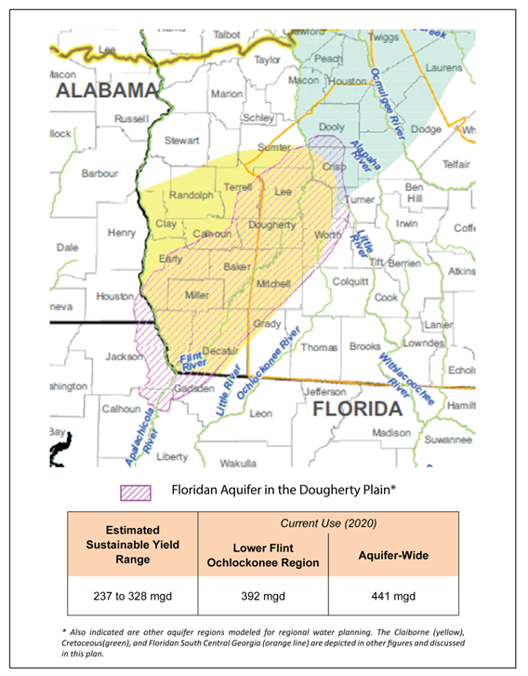
Discussion: Example of new groundwater assessment figure
Notes:
This is an example of the new figures in the groundwater availability section. The figures help to differentiate between planning region and aquifer-wide estimates.

Slide 39
Break for Group Photo and Lunch

Slide 40
Spalding County Sewer Feasibility Study
Joseph Johnson, Spalding County Water & Sewerage Facilities Authority

Slide 41

SEWER FEASIBILITY STUDY

Slide 42
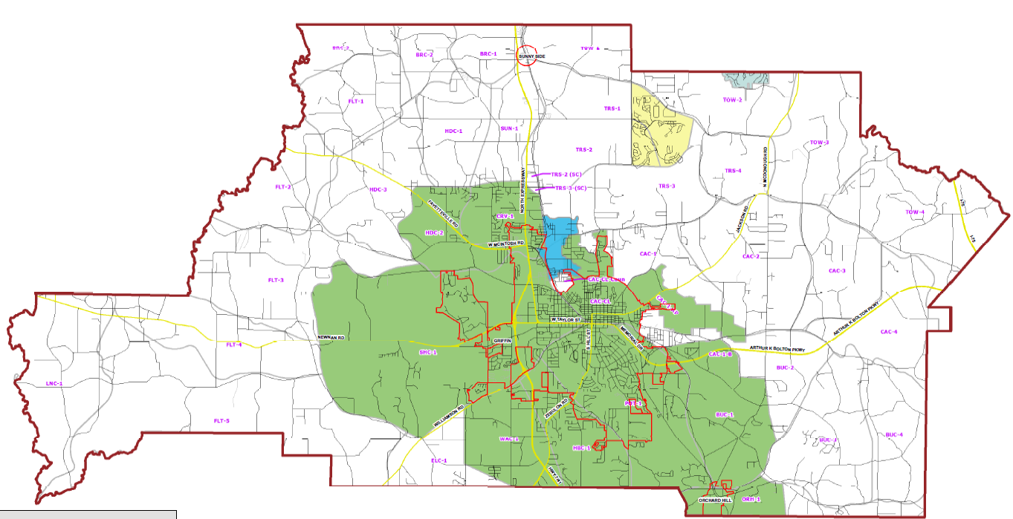
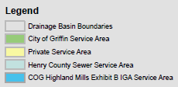

SDS Sewer Service Area

Slide 43
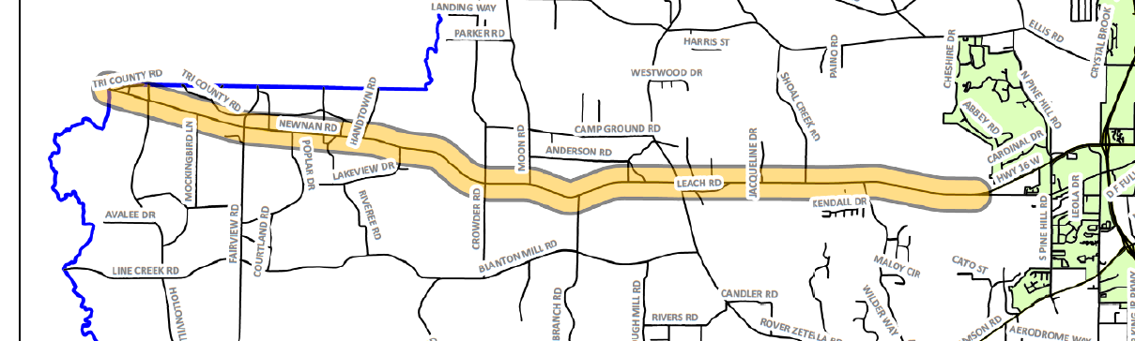

Target Area #1 – Newnan West Corridor
Limits – West of City of Griffin City Limits from West Poplar Avenue to Spalding/Coweta County line
Justification – Address residential housing pressure migrating East from Coweta County

Slide 44
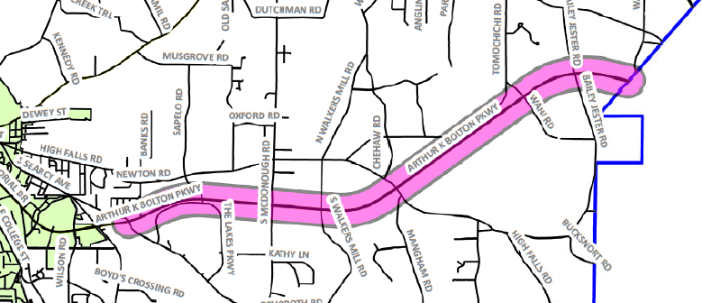
Target Area #2 – Arthur K Bolton (AKB) East Corridor
Limits – East of City of Griffin City Limits along AKB from Barrow Road to Spalding/Butts County line
Justification – Address Industrial and Commercial growth

Slide 45
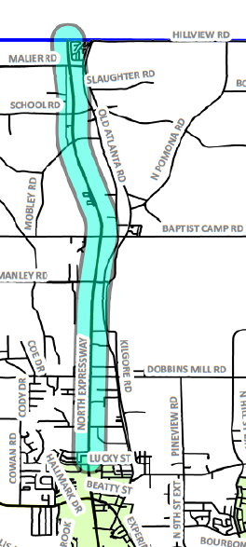
Target Area #3 – North Expressway North Corridor
Limits – North of City of Griffin City Limits along North Expressway Spalding/Henry County line
Justification – Address Commercial growth and known septic tank issues

Slide 46
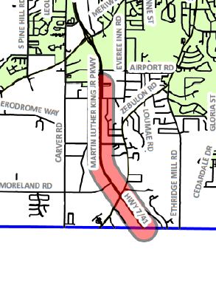
Target Area #4 – Tri-County Corridor
Limits – South of City of Griffin City Limits along Martin Luther K Jr. Pkwy from Airport Road to Spalding/Lamar County line
Justification – Address Commercial growth stalled due to the City of Griffin’s Sewer Moratorium

Slide 47
Project Timeline

Slide 48

Questions
Contact information:
Joseph Johnson, PE
General Manager
josephjohnson@spaldingcounty.com
O: 770-467-4777
C: 678-544-4170

Slide 49
Forecast Dashboard Update
Black & Veatch

Slide 50
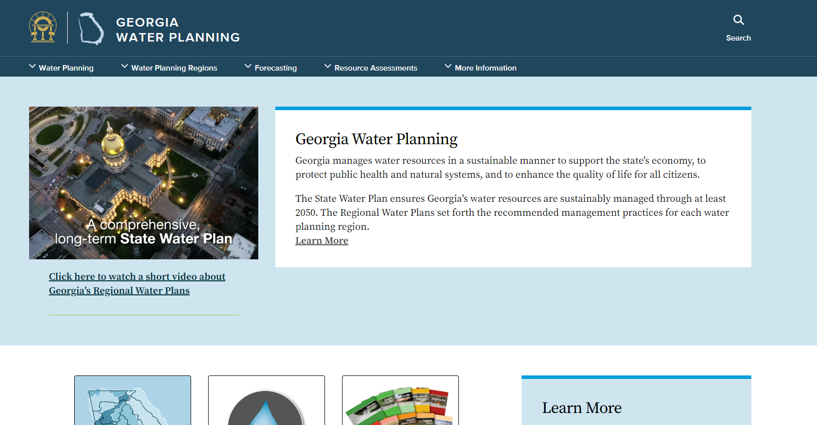
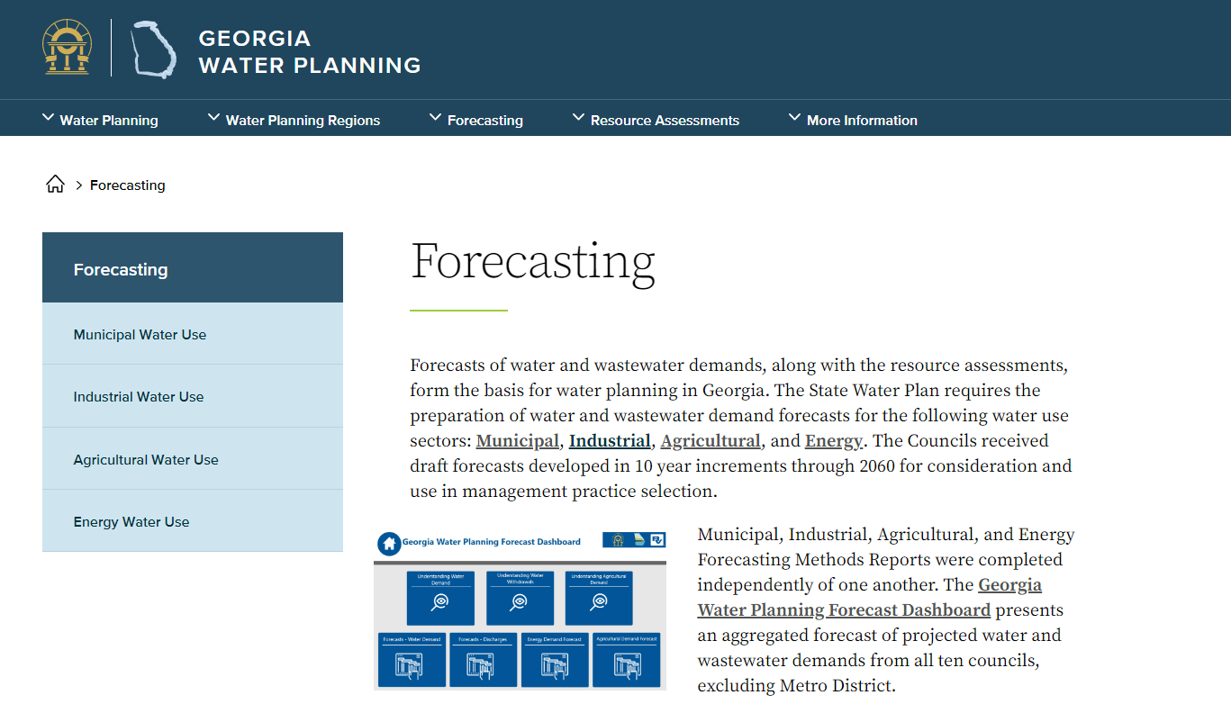
Forecast Dashboard
Available NOW on the Georgia Water Planning Website

Slide 51
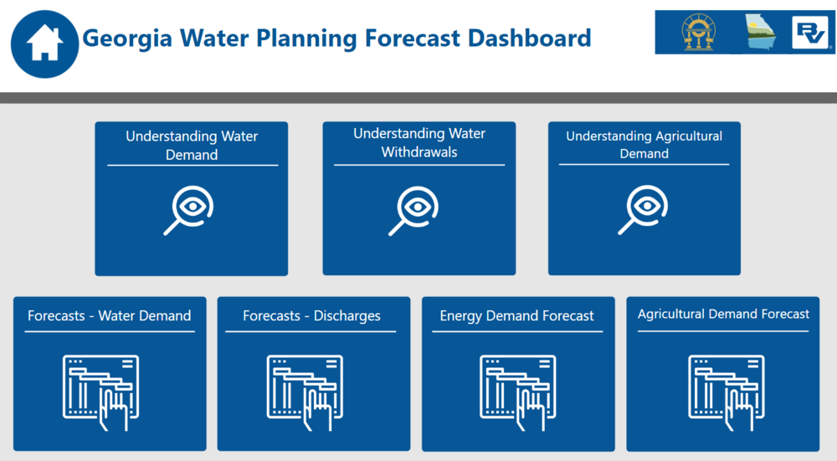

Forecast Dashboard

Slide 52
EPD Updates
Johanna Smith

Slide 53
Inter-Council Coordination Committee Report
Presented by Beth English

Slide 54
Inter-Council Coordination Committee
October 12, 2022
Upper Flint
Hugh Dollar
Jay Smith
Jimmy Webb
Beth English
Lower Flint - Ochlockonee
Middle Chattahoochee
Steve Davis
Harry Lange
Ken Van Horn
Patrick Bowie

Slide 55
Inter-Council Coordination Committee Report
Meeting on October 12, 2022
Reviewed and Discussed JT-3
  Reviewed existing language
  Reviewed optional alternative language
  Discussed collaborated agreed removal
Select representative to present at August council meeting

Slide 56
Inter-Council Coordination Committee Report
JT-3: Original Text from 2017 Plan
Consider the creation of a new coordinated, interstate planning organization for the ACF System. Membership in this organization to represent Georgia shall include, but not be limited to, members of the regional water planning councils with water planning regions that include parts of the ACF. Consider the recommendation of the ACF Stakeholders in its Sustainable Water Management Plan regarding an ACF transboundary water management institution as this organization is developed.

Slide 57
Inter-Council Coordination Committee Report
JT-3: Alternative 1
Consider the creation of a new coordinated, interstate planning organization for the ACF System. Membership in this organization to represent Georgia shall include, but not be limited to, members of the regional water planning councils with water planning regions that include parts of the ACF.
JT-3: Alternative 2 (revised during discussion)
The Councils recommend the proactive development of and/or engagement with a (an existing) tristate framework designed to address interstate water issues in the future and the inclusion of the regional water planning councils within this framework. Consider providing a framework to update the previous ACF Compact.

Slide 58
Inter-Council Coordination Committee Report
Recommendation to Council
Ultimately, it was determined that all three councils did not view JT-3 as a priority recommendation to the State; therefore, the Joint Recommendation JT-3 will not be included in the updated plans.
Each council can discuss the inclusion of this recommendation in separate recommendation to the state.
Recommended Text:
  The Council recommends the proactive development of and/or engagement with a (or an existing) tristate framework designed to address interstate water issues in the future and the inclusion of the regional water planning councils within this framework. Consider providing a framework to update the previous ACF Compact.

Slide 59
Inter-Council Coordination Committee Report
Recommended Text:
The Councils recommend proactive engagement among Georgia, Alabama, and Florida to collaborate on opportunities to improve planning for shared water resources in the ACF Basin.

Slide 60
Break-Out Sessions
Water Quality / Water Quantity

Slide 61
Water Quantity Committee
Sections 3 & 5 Edits to Review
Section 3.1
  Revisions – USGS data, discussion of use estimates, ag meter data (pp. 3-2 & 3-4)
Section 3.2.1
  Added detail regarding reservoir operations in BEAM model (p. 3-6, highlighted)
Section 3.2.2
  Added to discussion of Floridan Aquifer results: Figures 3-10 and 3-11 – Maps of moratorium area and red/yellow/green management areas (pp. 3-24, 3-27, 3-28)
Section 5.2
  Floridan results – See revisions on p. 5-10 similar to those in Section 3.2.2
  Claiborne Aquifer county results: See added text based on committee input. (p. 5-11 to 5-12, highlighted)
Section 5.4
  Added text re: Floridan Aquifer results (p. 5-19)

Slide 62
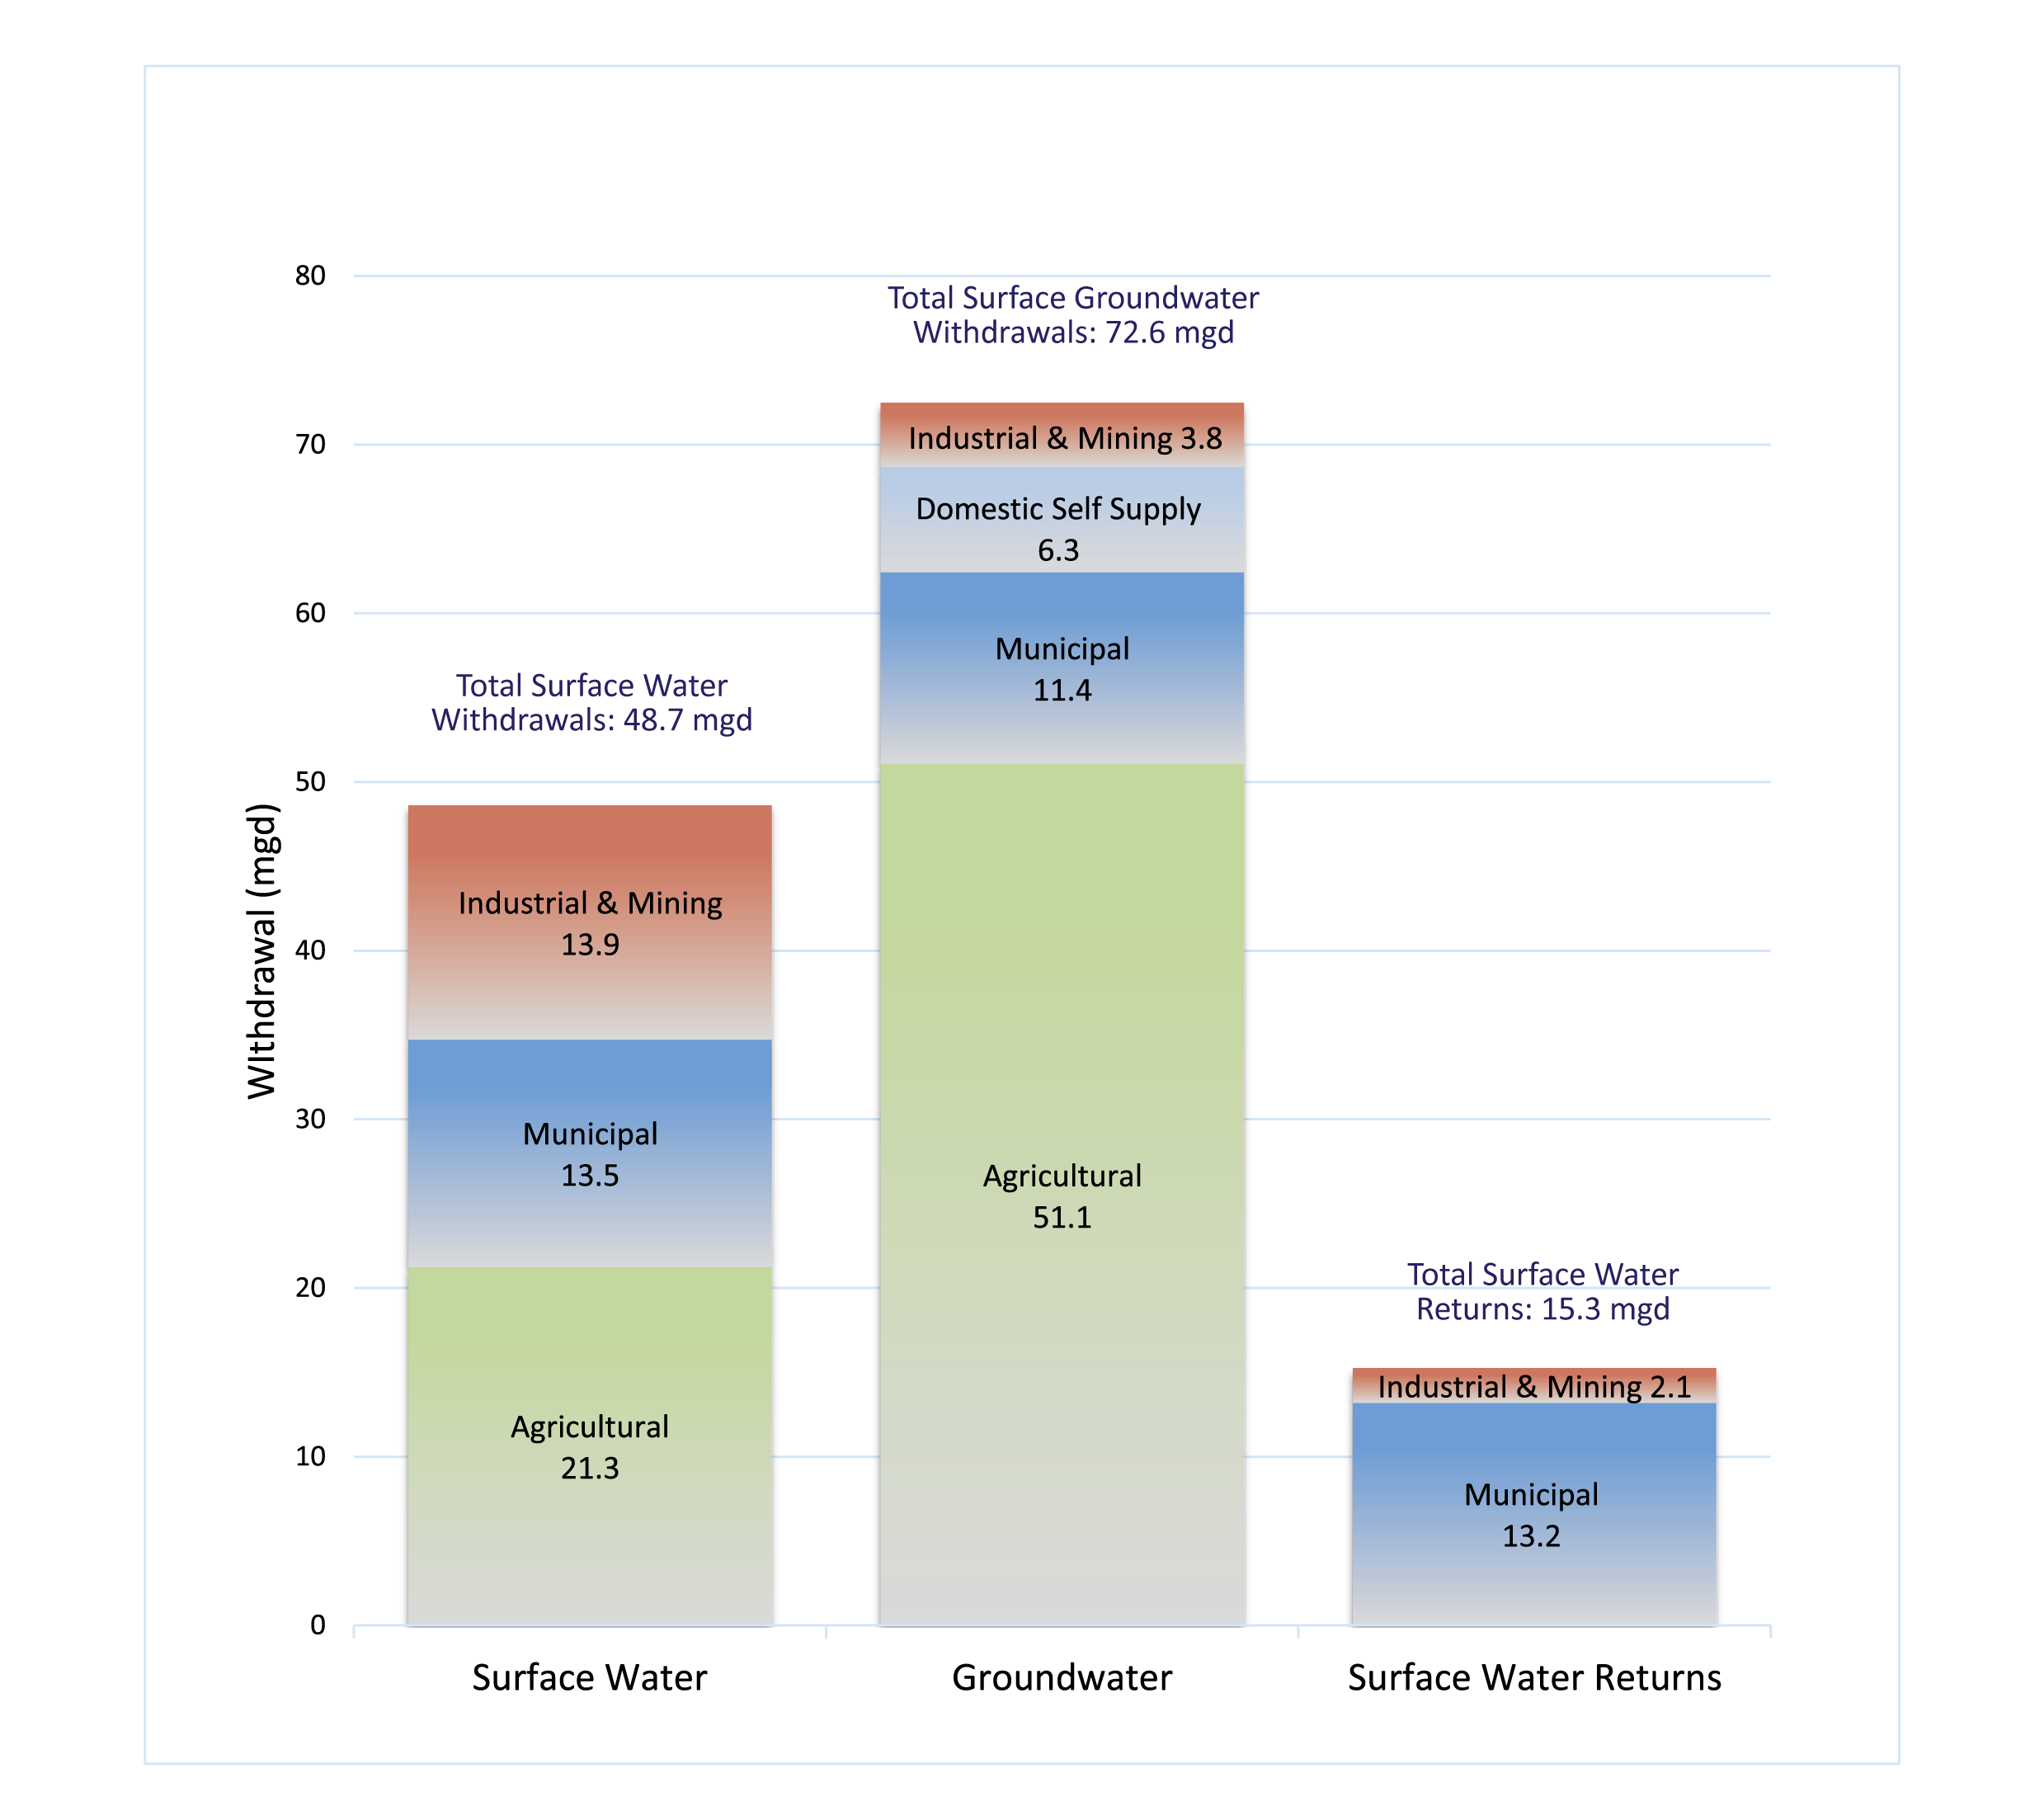
Water Quantity Committee Section 3.1
New graph with USGS 2015 data
New text (p. 3-2) on water use data, ag meters

Slide 63
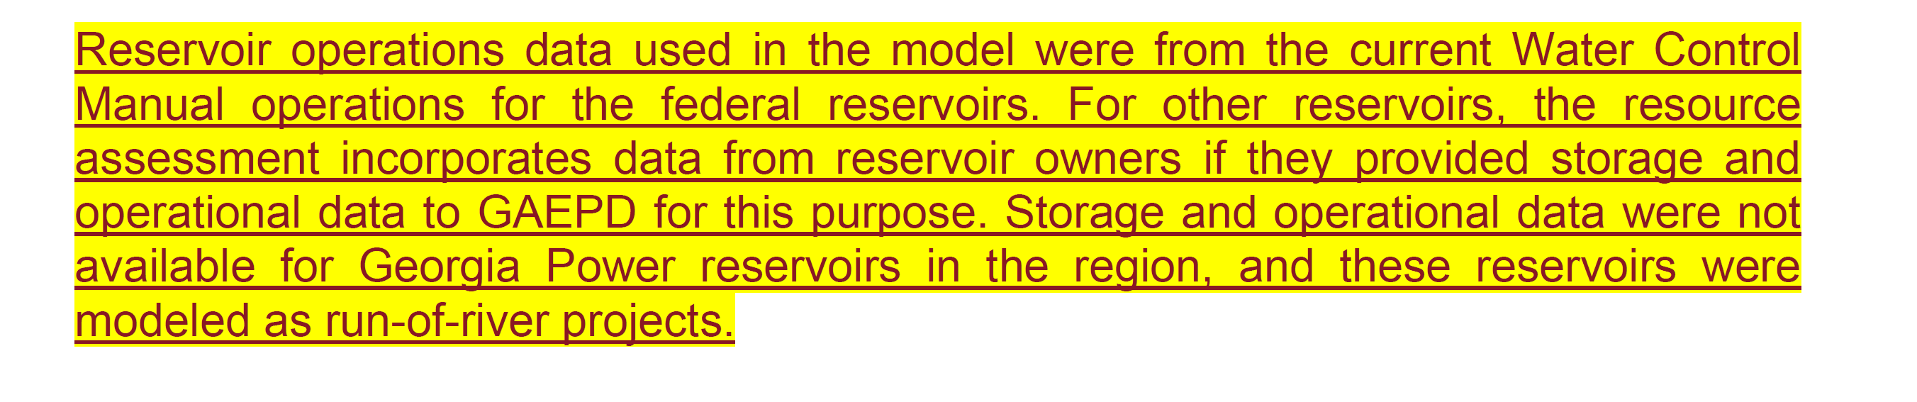
Water Quantity Committee
Section 3.2.1 Added detail about reservoir operations in BEAM (p. 3-6)

Slide 64
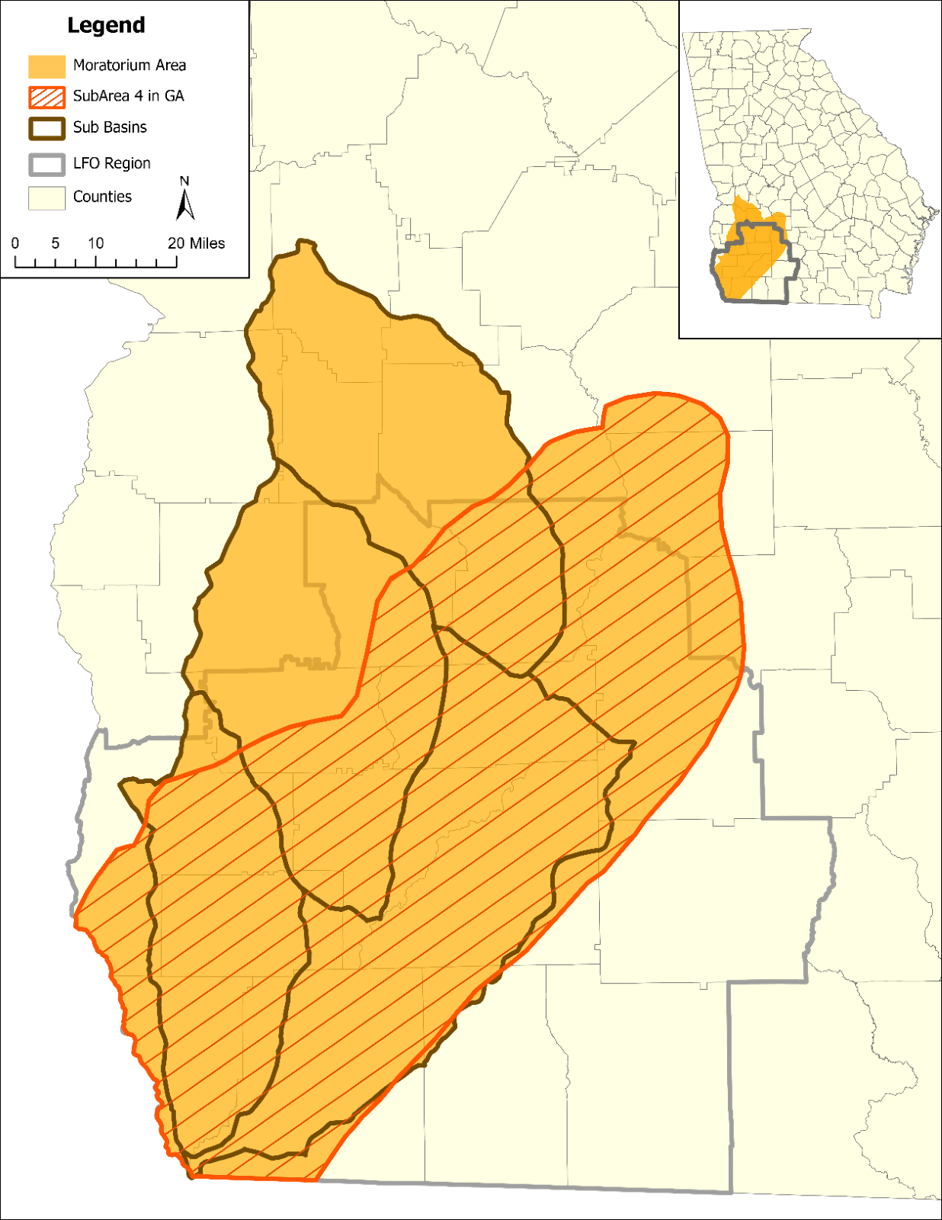
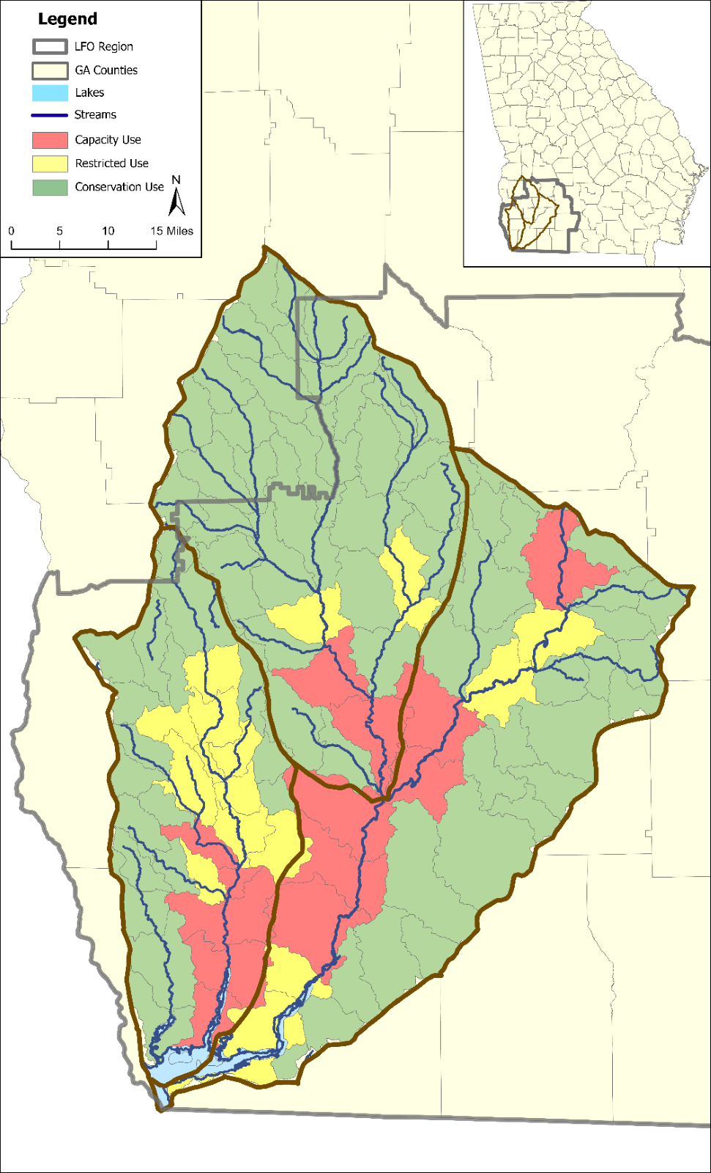
Water Quantity Committee
Section 3.2.2: New figures in Floridan Aquifer discussion
Figure 3-10: Moratorium on New and Expanded Agricultural Water Withdrawal Permits
Figure 3-11: Agricultural Water Withdrawal Permit Management Zones based on 2006 Flint Plan

Slide 65
Water Quantity Committee
Section 5.2 Claiborne Aquifer Results Discussion (pp. 5-11 to 5-12)
Table 5-9 includes county level estimates of sustainable yield and forecasted 2060 demands from the Claiborne Aquifer. These results indicate available sustainable yield across the region for this aquifer. However, as with any aquifer the potential for adverse impacts will be dependent on the location and concentration of withdrawals. Some areas may support increased use sustainably, while other parts may be more likely to experience potential adverse impacts of increased use. The next section describes an analysis of increased use of the Claiborne Aquifer that considers transient demands which vary over the course of the year with the agricultural growing season.

Slide 66
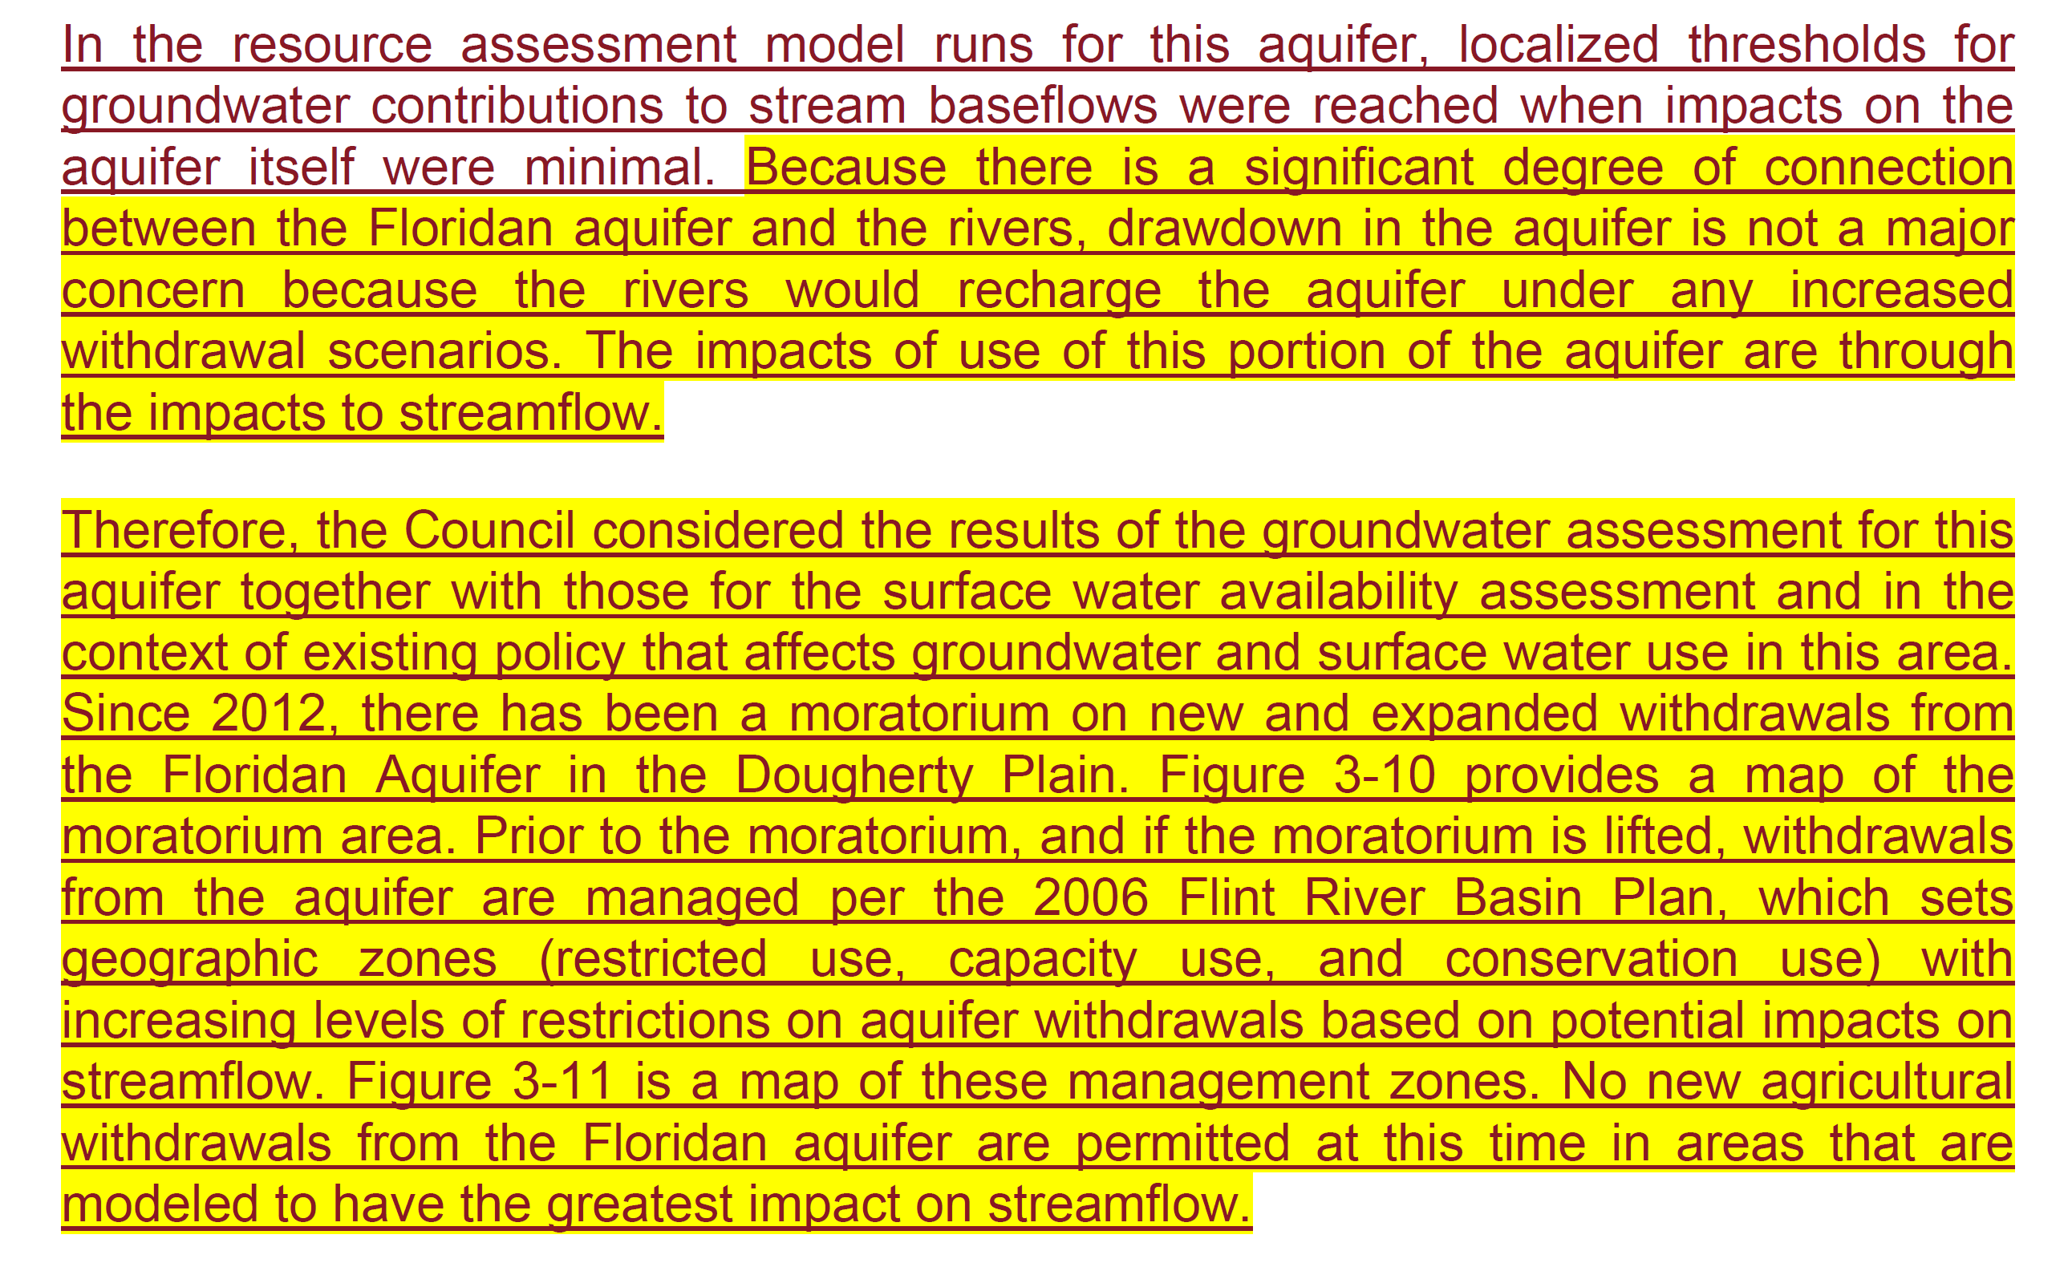
Water Quantity Committee
Text about Floridan results from Section 3.2.2 (p. 3-23)

Slide 67
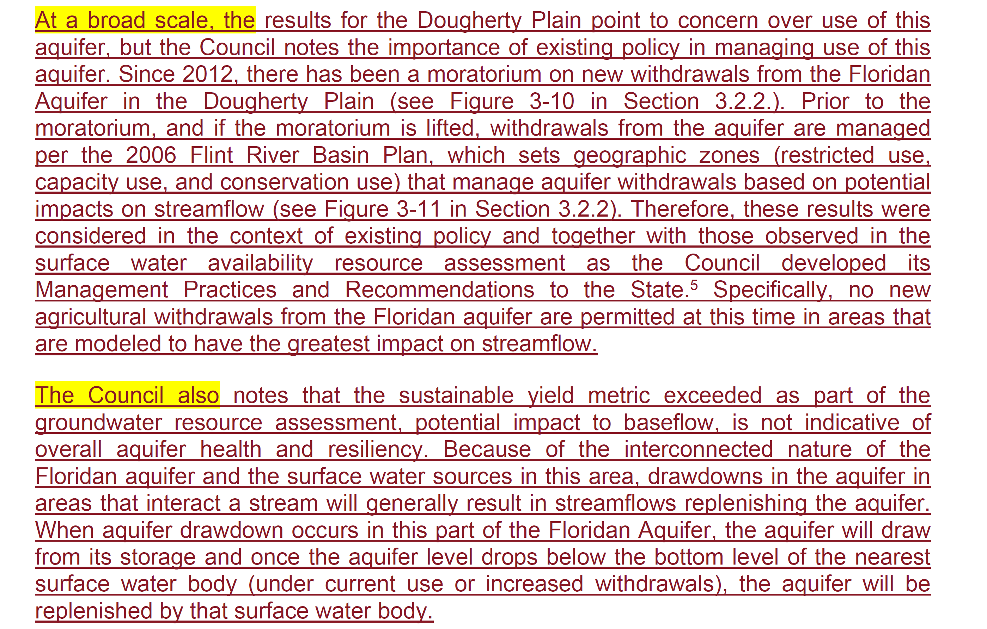
Water Quantity Committee
Text about Floridan results from Section 5.2 (p. 5-10)

Slide 68
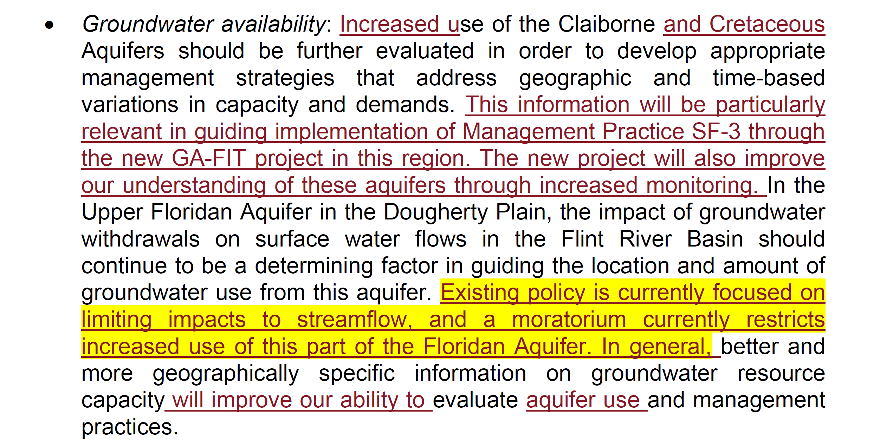
Water Quantity Committee
Section 5.4 Summary of Future Resource Assessment Results (p. 5-19)

Slide 69
Water Quantity Committee
Section 6.3: Recommendation WP-5 (p. 6-24)
WP-5: The Council recommends that irrigation suspension be used only through implementation of the Flint River Drought Protection Act, only by voluntary means, with notification to farmers before March 1 when possible, and only as a last resort when other options are not available to address severe flow depletions. The Council supports voluntary implementation of the voluntary irrigation suspension auction provided for by of the Flint River Drought Protection Act (OCGA §12-5-40) by EPD through an irrigation suspension auction, when absolutely necessary in abnormally dry periods and when other options are not available to address severe flow depletions during the growing season. When possible, GAEPD should provide notification of use of the Flint River Drought Protection Act before the March 1 drought declaration deadline. Earlier notification to farmers would inform planting decisions and help reduce the cost to farmers and to the state for irrigation suspension. Voluntary irrigation suspension is a temporary intervention to be targeted to the period of a growing season (or less, if possible). The Council acknowledges efforts to improve drought prediction tools to support earlier notification and supports GAEPD efforts to develop better predictive tools. The Flint River Drought Protection Act has not had a predictable source of funding in recent years, and a clear and reliable source of funding is needed. The Council also supports efforts by GA-FIT to develop and test new incentives for voluntary irrigation suspension in the Flint River Basin as a tool for drought response.

Slide 70
Storage Related Management Practices
SF1: Evaluate storage options in the Upper Flint River Basin that can provide for supply and flow augmentation in dry periods | The Council recommends creation of a study commission to evaluate storage options within the Upper Flint River Basin. A full range of storage and reservoir options should be evaluated, including farm ponds (see SF4) and inactive quarry sites, which have been used elsewhere to provide water storage capacity. The study commission’s evaluation should assess potential locations, viability, cost, and implementation. Costs should be evaluated in terms of potential in-stream water resource benefits, as well as other benefits. Locations should be evaluated in terms of providing smaller, but more frequent, possibilities for storage options throughout the region and State. The Council recognizes that new storage options are a long-term goal and encourage the development of water storage for the benefit of current and future generations.
SF4: Encourage greater utilization of new or Existing farm farm ponds in the Upper Flint Water Planning Region | On-farm water storage filled in periods of high flow can replace direct pumping for irrigation from surface streams or wells during drought periods. Future permits to fill farm pond withdrawals should include low flow protection requirements similar to those required in the Flint River Basin Water Development and Conservation Plan of 2006. Future surface water withdrawal permits for farm ponds should be conditioned such that the withdrawals do not contribute to the frequency or severity of low flow conditions in their local drainage areas. See Recommendation IN-7 in Section 6.3.

Slide 71
Storage Related Recommendations
IN-7: Evaluate the full water cycle impacts of irrigation and the impacts of small and medium impoundments on stream flows through intercepted drainage, evaporative loss, and water quality. GAEPD has advanced the understanding of how farm ponds are used in Georgia. However, better understanding of farm pond operation and impacts is needed to support more thorough evaluation. In particular, a better understanding of the impact of evaporative loss is needed.
IN-8: Conduct a dynamic analysis (under varied management, development, and climatic conditions in the region) to assess how conservation can optimize use of reservoir storage. Consider the results of this analysis when implementing Management Practice SF1 regarding the evaluation of water storage options in the Upper Flint Basin.
JT-1: Recognize the critical need for better use of existing storage and for more storage in the Apalachicola-Chattahoochee-Flint System and recommend that a plan for additional storage be developed and implemented and that it consider the following: better utilization of existing storage in the Chattahoochee River Basin, new storage in the Flint River Basin, and enhancement of existing storage capacity.

Slide 72
Storage Related Recommendations (cont.)
IN-12: Conduct a feasibility assessment of interventions that would improve flows in the Upper Flint River Basin. Evaluate each option with respect to costs, expected flow benefits, implementation barriers, and other factors that would affect the likelihood of success. The following potential interventions should be included in the feasibility assessment: • Convert LAS in the upper basin to sewer • Establish greater storage capacity in the upper basin • Reverse inter-basin transfers • Convert existing septic systems to sewer • Guide future development to sewer instead of septic • Changes in reservoir management by upper basin utilities The Council notes that these are not recommended interventions at this time but rather a set of potential options. Additional information on these options may support policy and planning that can effectively address flow restoration in the upper part of the Flint River Basin.

Slide 73
Break

Slide 74
Report from Small Groups & Plenary Discussion of Plan Revisions

Slide 75
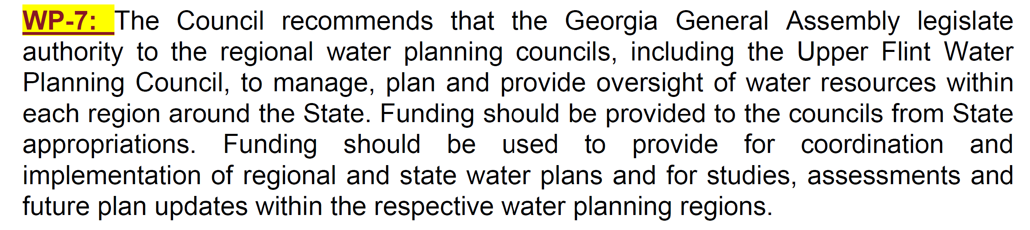
Section 6.3: Recommendation WP-7 (p. 6-25)

Slide 76
Section 6.3: Recommendation WP-8 & Joint Recommendation 3 (pp. 6-25 & 6-26)
WP-8: The Council urges the State to seek a timely resolution of current interstate water issues that directly affect the Apalachicola-Chattahoochee-Flint Basin. The Council recommends the development of a tristate framework designed to address interstate water issues in the future and the inclusion of the regional water planning councils within this framework. The Council requests that it be supported in making any updates to this Regional Water Plan as needed to address changes in ACF Basin management as a result of the settlement, resolution, or decision in on-going inter-state litigation or similar events that have the potential to substantially change how the Basin is managed.
Proposed Joint Recommendation: The Councils recommend proactive engagement among Georgia, Alabama, and Florida to collaborate on opportunities to improve planning for shared water resources in the ACF Basin.
Deleted – JT-3: Consider the creation of a new coordinated, interstate planning organization for
the ACF System. Membership in this organization to represent Georgia shall include, but not be limited to, members of the regional water planning councils with water planning regions that include parts of the ACF. Consider the recommendation of the ACF Stakeholders in its Sustainable Water Management Plan regarding an ACF transboundary water management institution as this organization is developed.

Slide 77
Next Steps in Plan Review and Revision
Meagan Szydzik

Slide 78
Next Steps
Next Meeting: March 21st, 2023
  Discuss High Priority Management Practices
  Reviewing Section 7: Implementation Schedule & Fiscal Implications of Management Practices
  Last review of the Plan before Public Review Period (Council will receive the full Plan to read over and suggest any final comments before the next meeting)
  After today’s meeting → Clean versions of the Plan to review without markup
  Committee Meetings?

Slide 79
Public Comment

Slide 80
Upper Flint BEAM Flows
BEAM unimpaired inflows (UIFs) should reflect historical volumes on a monthly basis and representative flow statistics on a daily basis, not reproduce historical daily flows
In original version of Baseline model, UIFs were artificially high as a result of missing data (historical reservoir elevations)
  Reservoirs were assumed to remain full when data were not available
  As a result, inflows were too high when storage was being drawn down and too low during refill
Results from the verification run were close to the gage flows because the reservoirs were assumed full when data was missing, a consistent assumption with the UIFs
However, when these same inflows were used with operating reservoirs in the baseline run, the basin had both the higher inflows and storage to draw from

Slide 81
Adjustments to the UIFs
Additional historical elevation data was collected
  JW Smith (2000-present) and Shoal Creek (2009-present)
    Shoal Creek was added to model as its own node
  Horton, Kedron (2015-present)
Some estimates were created based on monthly drawdown reports
  Horton, Kedron (2005-2015)
There is still some missing/unavailable data that will resulting in elevated inflows during drought periods
  Horton (pre 05), Kedron (pre 05), Heads Creek (pre 6/10), Still Branch (pre 5/07), JW Smith (pre 00) and Shoal Creek (pre 09), McIntosh, Peachtree
Some additional clean-up as well (e.g., evap effects added, pumping to JW Smith had been treated as a consumptive use)

Slide 82
Comparison to Gage Flows
 |  |  | observed | BEAM v1.3 | BEAM v1.4
2001-2017 | Carsonville | ave (cfs) | 1766 | 1794 | 1782
 |  | % diff from gage |  | 1.6% | 0.9%
 | Griffin | ave (cfs) | 274 | 292 | 285
 |  | % diff from gage |  | 6.8% | 4.3%
Drought Periods (4/1/2012-12/31/2012 5/1/2007-12/31/2008 6/1/2016-12/31/2016) | Carsonville | ave (cfs) | 502 | 530 | 510
 |  | % diff from gage |  | 5.7% | 1.6%
 | Griffin | ave (cfs) | 85 | 101 | 90
 |  | % diff from gage |  | 18.6% | 5.8%
The model flows should NOT match the gage flows because of different withdrawals and reservoir operations
The updates to the UIF do, however, reduce the artificially high inflows during drought

Slide 86
